Slide 1


EarLy Elimination of Fatty Acids iN hypertriglyceridemia (HTG)-induced acuTe pancreatitis (ELEFANT trial): open-label, multicenter, adaptive randomized clinical trial
Péter J. Hegyi

Slide 2
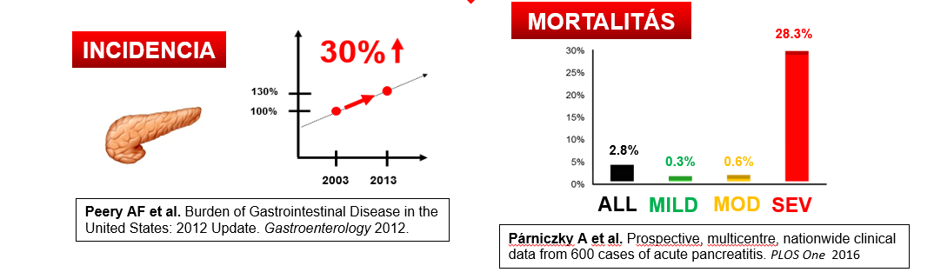
Most common acute inpatient gastroenterological disease
MORTALITY
INCIDENCE

Slide 3
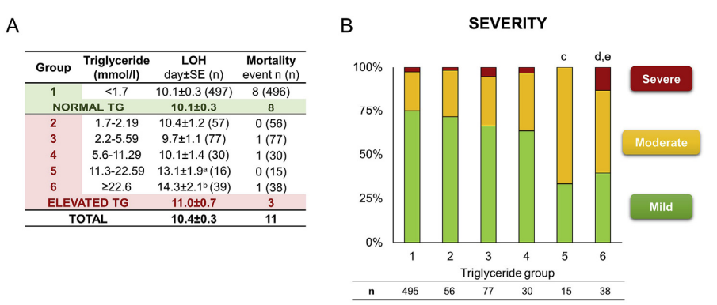
BACKGROUND 1/2
HTG dose-dependently aggravates the SEVERITY and related COMPICATIONS of AP. ^{1,2}
Combined rate of severe AP and mortality is significantly higher in HTG-induced AP vs. other etiologies of AP (12.7 vs. 4.2%, respectively).¹
1)Mosztbacher D. et al.: Hypertriglyceridemia-induced acute pancreatitis: A prospective, multicenter, international cohort analysis of 716 acute pancreatitis cases. Pancreatology. 2022
2)Zhang R et al: Hypertriglyceridaemia-associated acute pancreatitis: diagnosis and impact on severity. HPB, 2019

Slide 4
BACKGROUND 2/2
HTG affects 10-30% of the general adult population.^{1,3}
HTG-AP is the third most common cause of acute pancreatitis.^{2,3}
HTG-AP is responsible for up to 15% of AP cases. ⁴
1)Ford ES et al.: Hypertriglyceridemia and its pharmacologic treatment among US adults. Arch Intern Med 2009
2)Parniczky A et al.: Prospective, Multicentre, Nationwide Clinical Data from 600 Cases of Acute Pancreatitis. PlosOne, 2016
3)Mosztbacher D. et al.: Hypertriglyceridemia-induced acute pancreatitis: A prospective, multicenter, international cohort analysis of 716 acute pancreatitis cases. Pancreatology. 2022
4)Zhu Y et al: A study on the etiology, severity, and mortality of 3260 patients with acute pancreatitis according to the revised Atlanta classification in Jiangxi, China over an 8-year period. Pancreas 2017

Slide 5
DESIGN
International, multicenter, three-armed, randomized controlled clinical trial
Patients with HTG- AP
SUBINTENSIVE CARE
A
C
patients with aggressive fluid resuscitation
patients who undergo plasmapheresis and receive aggressive fluid resuscitation
B
patients who receive continuous infusion of insulin combined with sc. heparin with aggressive fluid resuscitation

Slide 6
INCLUSION CRITERIA
1. age 18-80 years
2. diagnosed AP on the basis of the “2 out of 3” criteria in the
IAP/APA guidelines
3. HTG is diagnosed: if the blood TG level is at least 1000 mg/dL
(11.3 mmol/L)
4. signed informed consent

Slide 7
EXCLUSION CRITERIA
1. pregnancy or breast feeding
2. any of the interventions is not available within 48 h calculated from the start of abdominal pain
3. any of the interventions can not be started within 12 h calculated from the venepuncture, which
provided the blood sample for HTG analysis
4. coma
5. malignancy
6. early ARDS
7. renal failure
8. allergy to insulin or heparin
9. chronic pancreatitis
10. hospitalization before admission
11. any reasons contraindicating plasmapheresis: severe active bleeding or disseminated
intravascular coagulation
12. other forms of coagulopathy
13. hemodynamic instability; potassium plasma levels ≤ 3.5 mEq/L
14. sepsis, allergy to albumin, chronic heart failure
15. symptoms of fluid overload at recruitment or long QT syndrome

Slide 8
SAMPLE SIZE
495 patients
Primary endpoint:
The primary endpoint is a composite endpoint, which is based on the summation of cases with severe AP or mortality Severe AP is determined according to the revised Atlanta Classification (RAC).
Secondary endpoint:
(1) serum TG level; (2) serum albumin level; (3) serum Ca level; (4) pain according to the visual analogue scale 1, 2 and 3 days after randomization; (5) C-reactive protein serum levels; (6) leukocyte count; (7) length of hospital stay; (8) need for ICU admission; (9) length of ICU stay; (10) organ failure (divided into transient and persistent organ failure according to the RAC definitions); (11) complications of plasmapheresis; and (12) cost calculation.

Slide 9
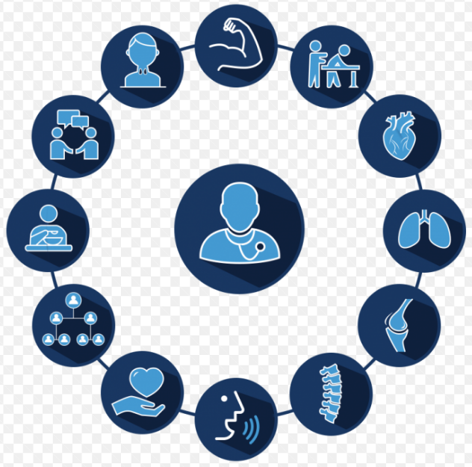
Subintensive care unit
Intensive care unit
HotLine 24/7
Multidisciplinary team
consultant
PhD student
resident doctors
researchers
Nurse stuff
physiotherapist
PATIENT
patient transporter
dietitians
financial officer
endoscopist
psychologist
radiologist
employer social services
TDK student
administrator
informatic

Slide 10
DAILY ROUTINE
Administrators
Completing patient information leaflet and consent forms
Questioning patients on a daily basis
Collection of biological samples and delivery to the biobank
Collection of patient documentation
Uploading data to the register interface– ECDMS
Check of the uploaded data
Report the current situation to Local Investigator

Slide 11

THREE-LEVEL MONITORING
ADMINISTRATOR
DOCTOR / PROFESSIONAL
FINAL PROFESSIONAL

Slide 12
TAKE HOME MESSAGE
It has shown a rising incidence worldwide – as a result of increasing obesity-related dyslipidemia^{1,2}
It raises the risk of severe AP and related complications^{3,4}
There is no evidence-based therapy for it ^{5,6}
1)Khauta B. et al.: Obesity and pancreatitis. Curr Opin Gastroenterol.2017
2)Czapári D. et al.: Cardiac failure, sepsis and cancer-induced cachexia markedly increase mortality following acute pancreatitis. New England Journal - Under review
3)Zhang R et al: Hypertriglyceridaemia-associated acute pancreatitis: diagnosis and impact on severity. HPB, 2019
4)Kiss L. et al.: The effect of serum triglyceride concentration on the outcome of acute pancreatitis: systematic review and meta-analysis. Sci Rep. 2018
5)IAP WG, Guidelines AAP. IAP/APA evidence-based guidelines for the management of acute pancreatitis. Pancreatology. 2013
6)Hritz I. et. al.: Acute pancreatitis. Evidence based management guidelines of the Hungarian Pancreatic Study Group. Orv Hetil.2015

Slide 13
„Good judgement is the result of experience and experience the result of bad judgement.”
Mark Twain

