Slide 1






Szepszis és szeptikus sokk Molnár Zsolt^{1,2,3,4} ¹Medical Director: CytoSorbents Europe, Berlin, Germany ²Institute for Translational Medicine, School of Medicine, University of Pécs, Hungary ³Department of Anaesthesiology and Intensive Therapy, Poznan University of Medical Sciences, Poznan, Poland ⁴Department of Anaesthesiology and Intensive Therapy, Markusovszky Teaching Hospital, Szombathely, Hungary

Slide 2




Pathophysiology

Slide 3
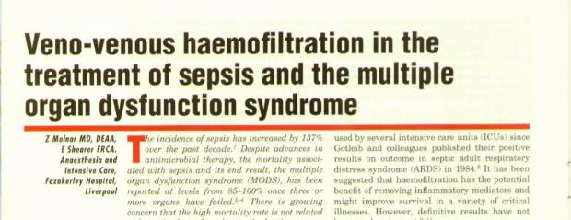
Sepsis and
I n s u l t
Endotoxin, Trauma, Sterile
inflammation, Operation, etc.
Humoral activity
Interferon, Complement
Sepsis & Love
M a c r o p h a g e s
TNF; IL-1,6,10; PAF
P M N
FR, PAF, Chemotaxis
Fisiol. reactions
Fever, Metabolic changes
The key isn’t the insult but the host response
E n d o t h e l
NO, E-selectin, NFkB
Sepsis, SIRS
MSOF
Molnár and Shearer Br J Int Care Med 1998; 8: 12

Slide 4
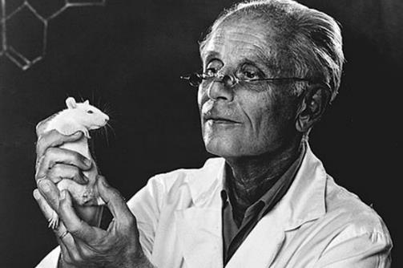
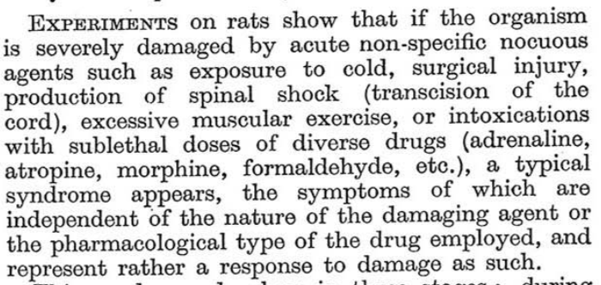
János (Hans) Selye
1907-1982
This was the discovery of „stress”

Slide 5
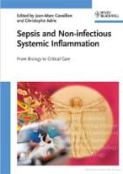
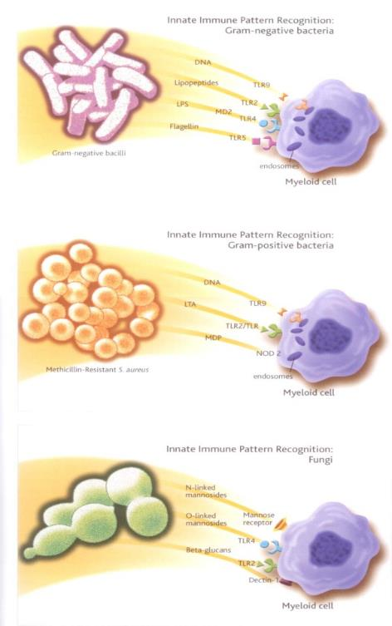
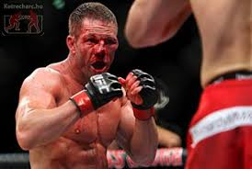
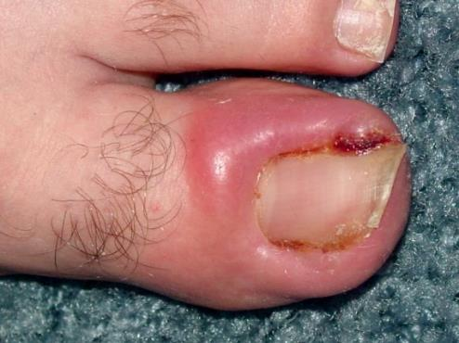
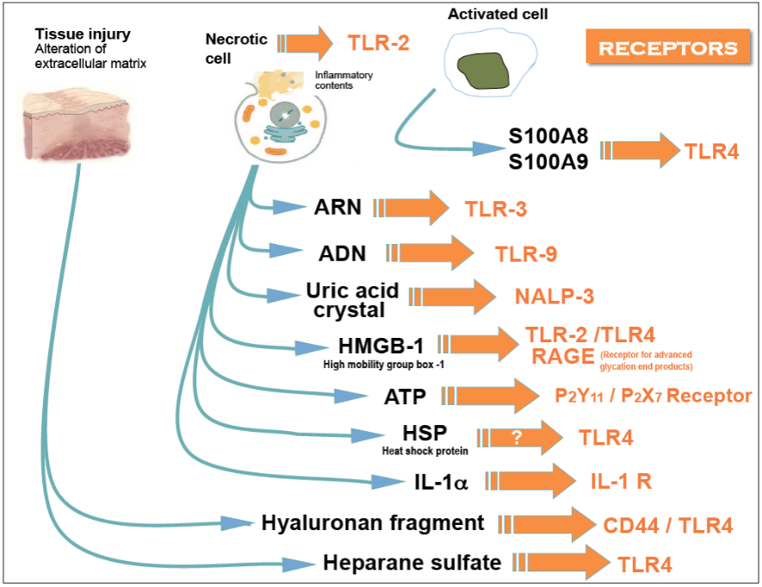

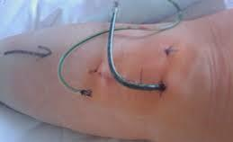
Injury: DAMP or PAMP
DAMP
Damage Associated Molecular Pattern
PAMP
Pathogen Associated Molecular Pattern
G+
Inflammatory response is essential to conquer injuries.
G-
But only, if it is a „healthy” response
F

Slide 6

Acid
Base
Pro-coagulation
Anti-coagulation
Oxidants
Anti-oxidants
Pro-inflammation
Anti-inflammation

Slide 7
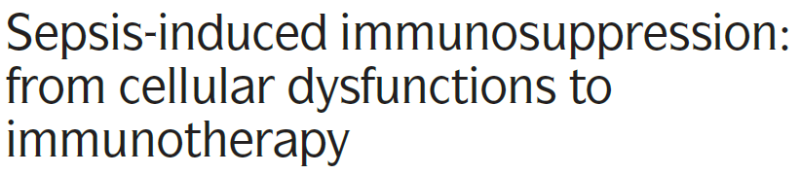
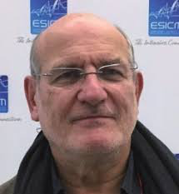
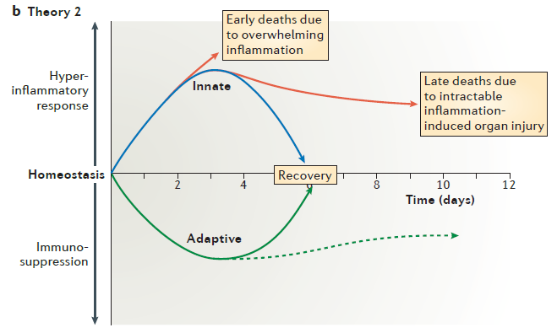
Nature Reviews | Immunology Volume 13 | December 2013 | 862-874
Pro-inflammation
This is why SIRS was a wrong concept
Anti-inflammation

Slide 8
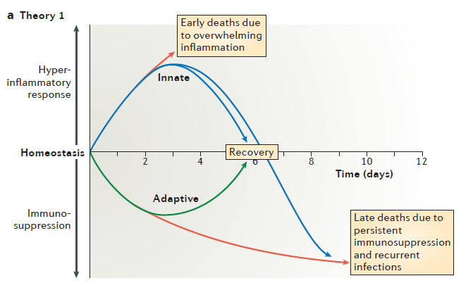
Nature Reviews | Immunology Volume 13 | December 2013 | 862-874
Pro-inlflammation
Anti-inlflammation

Slide 9
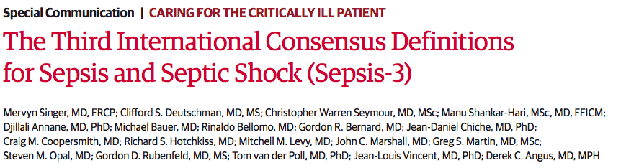
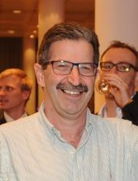
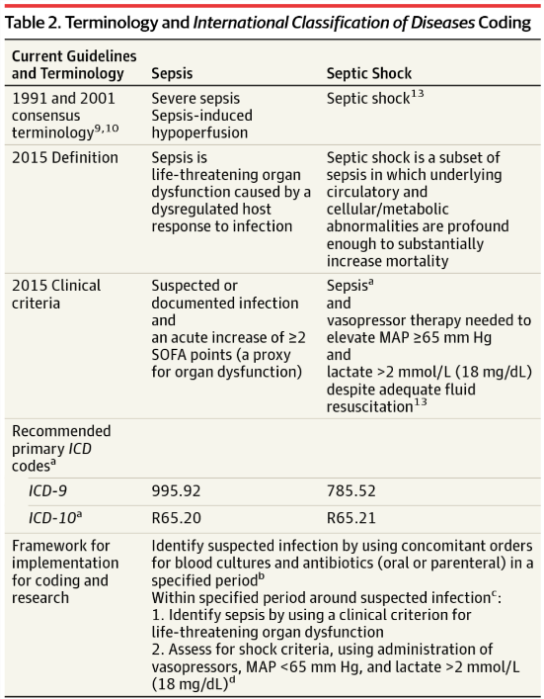
Organ dysfunction
+
dysregulated host response
Sepsis in NOT a definitve disease

Slide 10
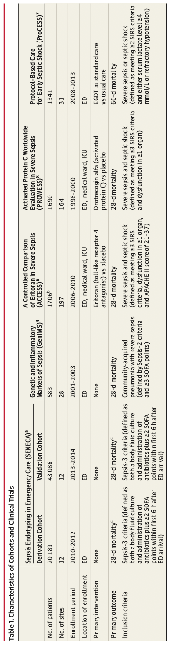
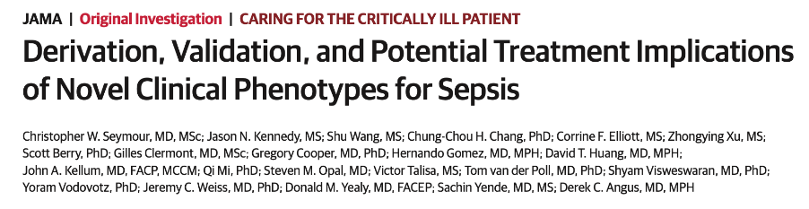

Slide 11
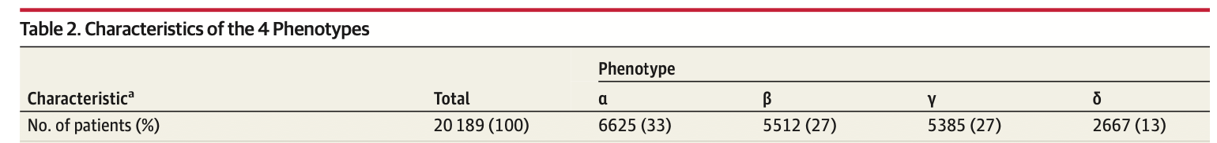
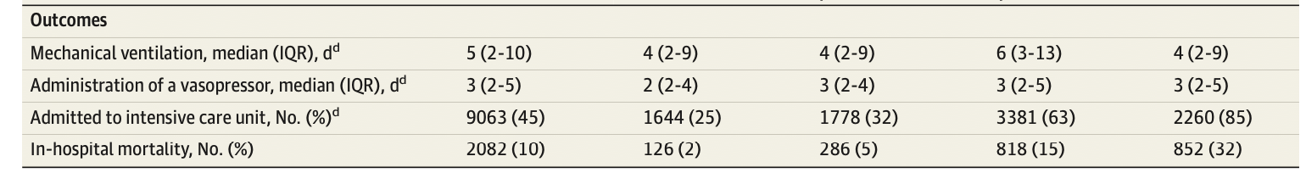
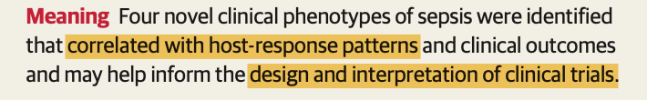

Slide 12

Is this patient septic or not?

Slide 13

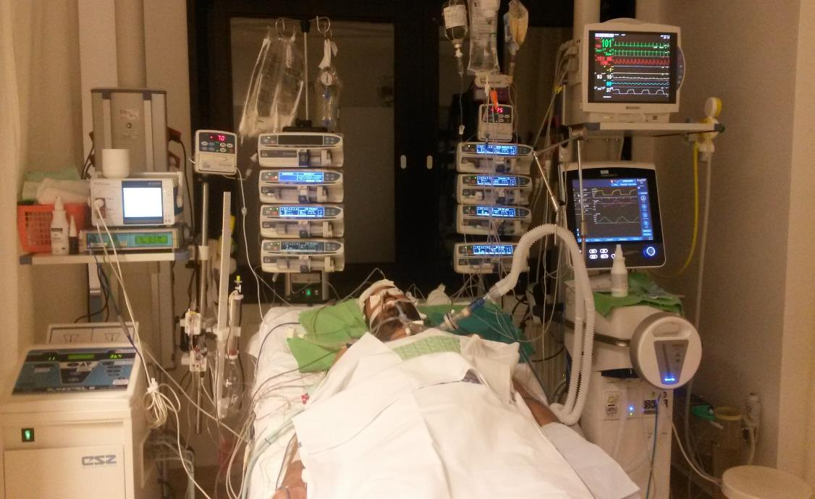
I have never treated „SEPSIS” in my life!
Hemodynamic instability
Respiratory dysfunction
You don’t treat Sepsis!
Renal dysfunction
But organ dysfunction - and infection
Etc, etc, etc....
Altered mentation
Etc, etc, ....

Slide 14

Confession
2013: ISICEM, Brüsszel
I have never treated ARDS per se in my entire life…
…and you haven’t done either ☺

Slide 15


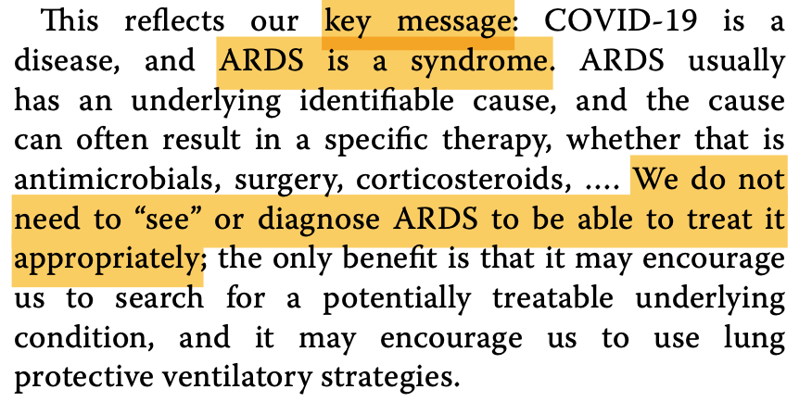

Slide 16
Does the patient have infection or not ?
Infection = ABs
No Infection = no ABs

Slide 17

Signs of infection
Not good enough
Clinical signs:
Most important
Fever (>38ºC), WBC (>12 000):
Low sensitivity (~50%)
Galicier L and Richet H. Infect Control Hosp Epidemol 1985; 6: 487
Trasy D, et al. J Immunol Res 2016; http://dx.doi.org/10.1155/2016/3530752
Microbiology:
Results: 24 hours or more
Several fals positive or fals negative results
Poooor!
Very late!

Slide 18
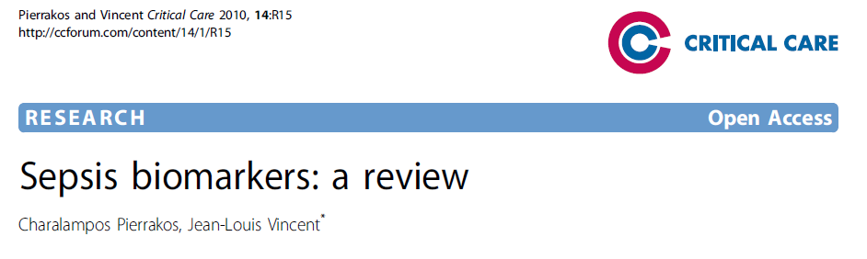
We need biomarkers!
Inflammatory
WARNING!
Using biomarkers is not easy
I PCT

Slide 19
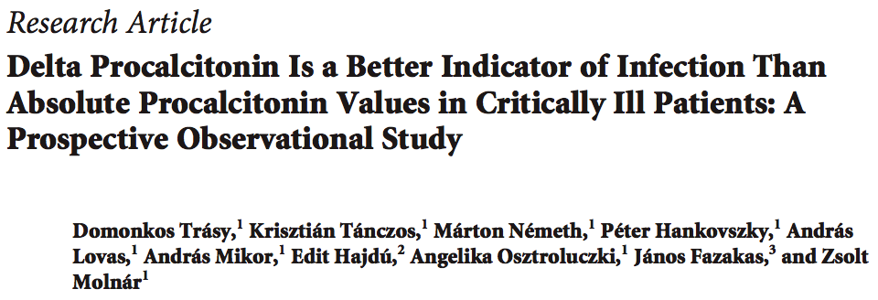
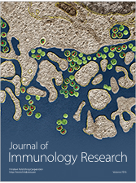
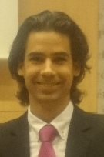

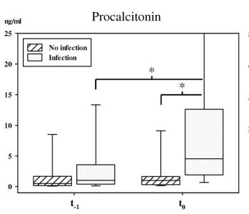
Patients with
suspected infection = 209
Infection = 85
PCT available at T₋₁ = 114
No-infection = 29
AUC ΔPCT: 0.85
ΔCRP, WBC, T

Slide 20
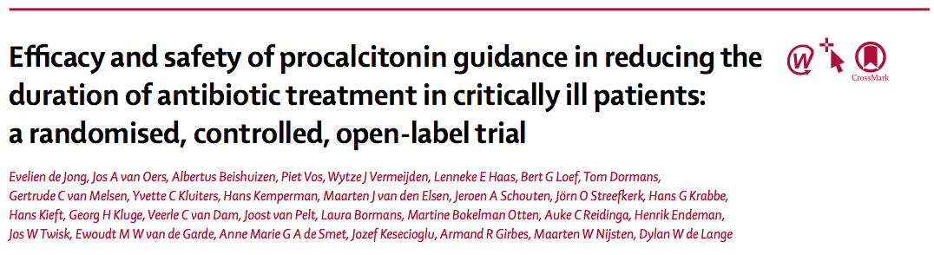
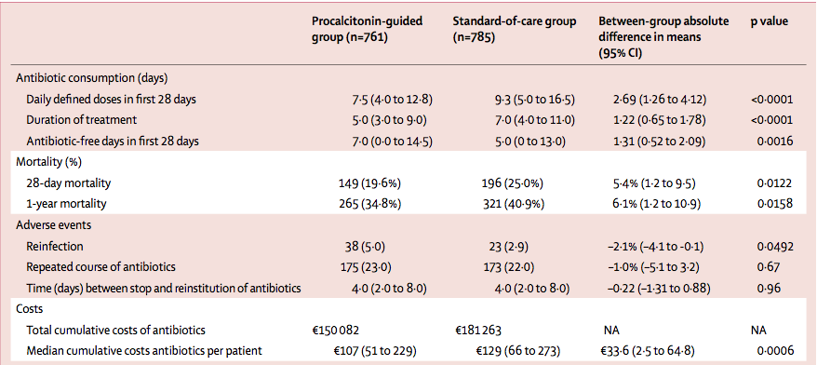
〈 2days ABs
Lancet Inf Dis 2016; 29 February
Reduced mortality
More reinfection
Reduced costs
Evaluating biomarker kinetics may help individualizing AB therapy – even in COVID-19

Slide 21
Mortality

Slide 22
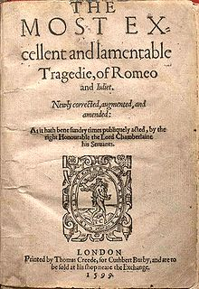
Love has been extensively researched
Mortality: 100% ☹
William Shakespeare: Romeo and Juliet, 1599

Slide 23
>15% reduction in mortality!
No deaths: 950
No deaths: 2500
Increase by >4 fold

Slide 24
Sepsis mortality around the Globe
Study | Design / data collection | [n] | Hospital Mortality | ICU stay (d) | Hospital stay (d)
Kaukonen et al. (2014) | Retrospektive, incidence, administrative data | 12,213 | 19,8 % | 3,2 (1,6-6,9) | 13,5 (7,0-25,9)
Levy et al. (2012) USA, 2005-2010 | Prospektive, registry, not representative | 18,766 | 28,3% | 4,2 (2,2-8,9) | 10,5 (5,8-18,9)
PROCESS (2014) | PRCT | 1,500 | ~20 %
ARISE (2014) | PRCT | 1,600 | ~20 %
Europe 2005-2010 | Prospektive, registry, not representative | 6,609 | 41,1% | 7,8 (3,4-17,2) | 22,8 (11,1-43,3)
Heublein et al. (2013) | Retrospektive, incidence study, administrative data | 89,907 | 46,5% | - | -
Engel et al. (2004) Deutschland, 2003 | Prospektive, one-day prevalence, representative | 415 | 55,2% | 12,3 (6-16) | 24 (13-38)
Jena Sepsisregistry Deutschland (Jena), 2011 | Prospektive, monocentric, incidence study, registry | 388 | 46,9% | 10 (4-23) | 27 (16-43,2)
(Courtesy of Prof. Brunkhorst)

Slide 25
Did we speak the same language?
Actual mortality: 65%

Slide 26
Treatment

Slide 27
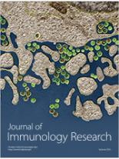
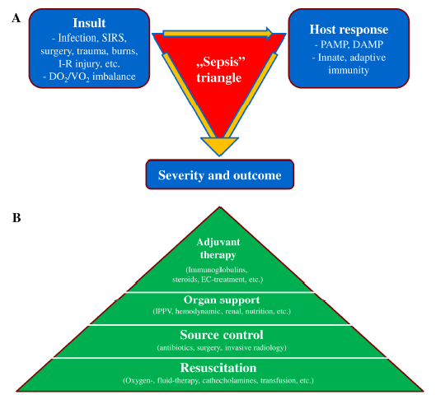
Journal of Immunology Research, 2015; Volume 2015, ID 510436, 13 pages
http://dx.doi.org/10.1155/2015/510436
EC cytokine-removal
Immuno-globulins
Steroids
....

Slide 28
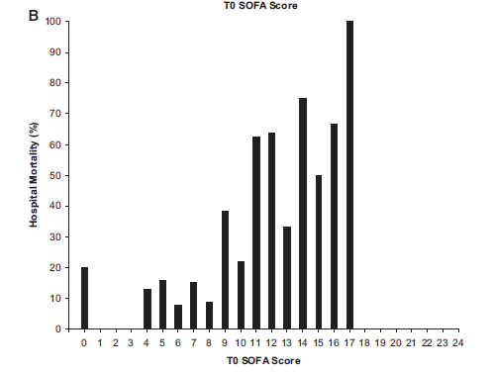
Basic resuscitation: O₂+Fluid+Pain relief
Jones AE, et al. Crit Care Med 2009; 37:1649 –1654
Mortality
Junior doctors have a pivotal role in the frontline!

Slide 29
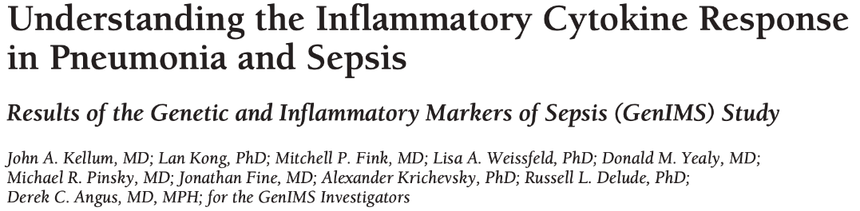
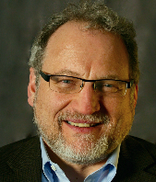
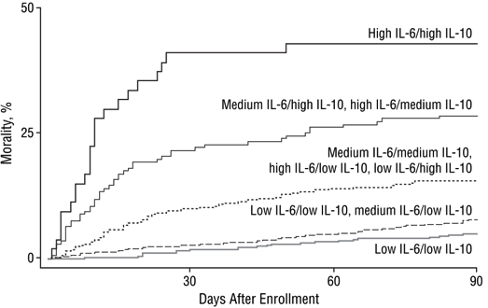
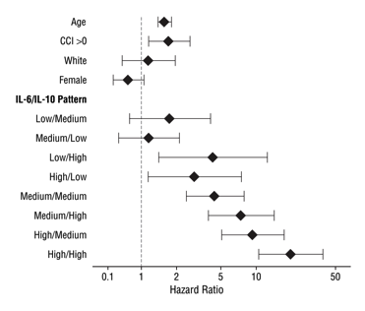
Blocking or reducing cytokine levels may be beneficial

Slide 30
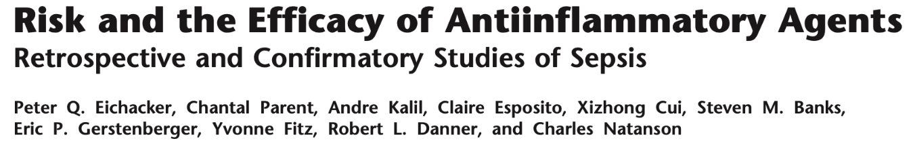
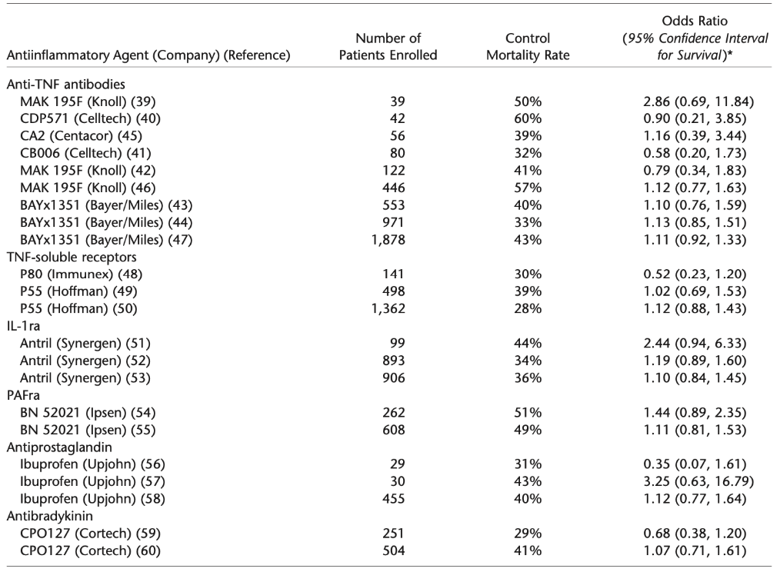

Slide 31
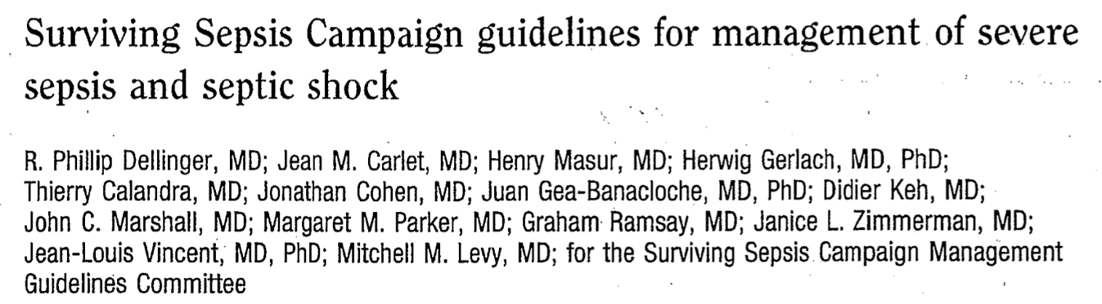
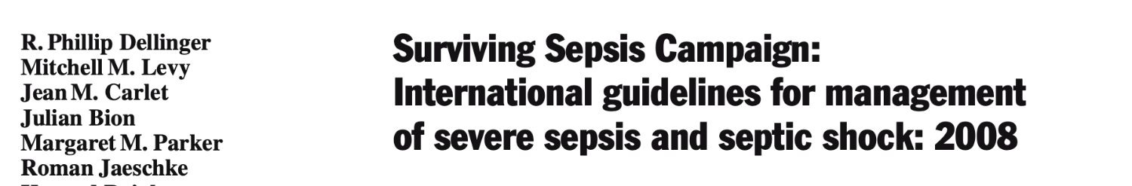
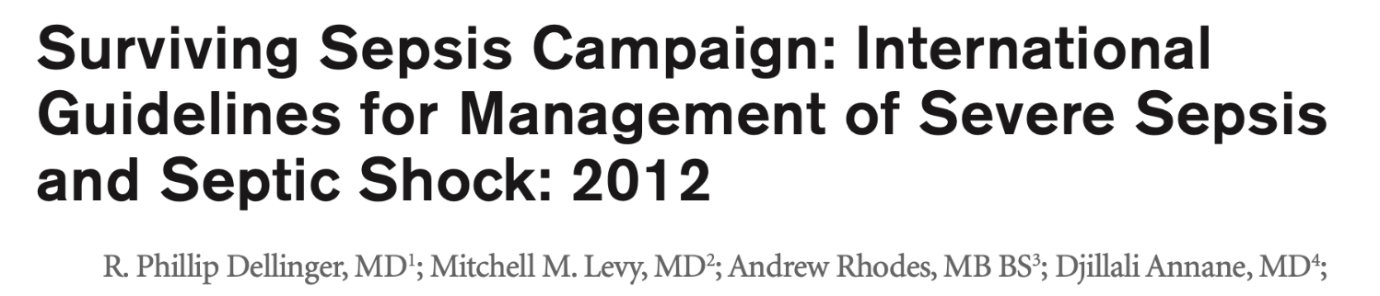

SSC Guidelines
Not a word on specific anti-cytokine therapies

Slide 32
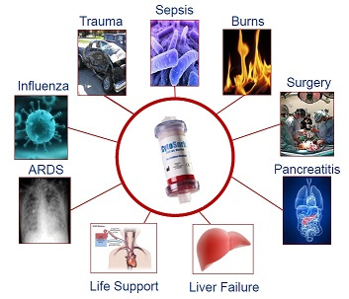
Modulating Dysregulated Immune Response
To regain balance
In both: PAMPs and DAMPs
In cases of refractory vasoplegic shock

Slide 33
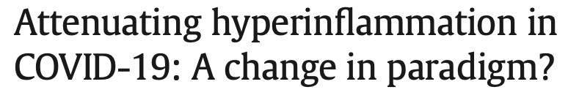

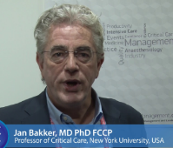
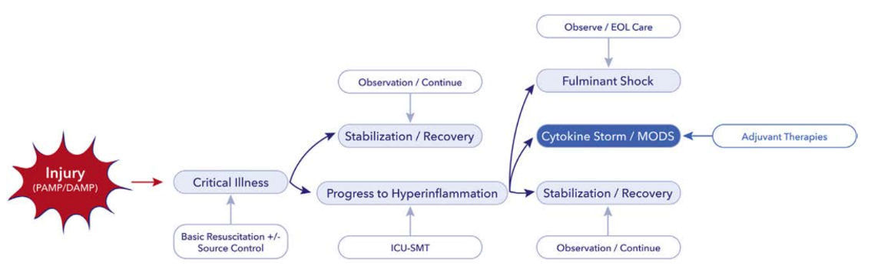
New terminologies:
Dysregulated immune response
Cytokine storm
Hyperinflammation
Vasoplegic shock – to replace “septic shock” (in DAMPs)
To replace SIRS

Slide 34
A szepszis – közös ügyünk

Slide 35
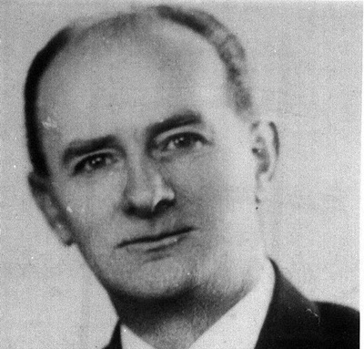
Az (akut) betegellátás közös ügyünk
Hamvas Béla
1897-1968
„A dolgokat csak egyféleképpen lehet rendbe rakni:
mindent és egyszerre.”

Slide 36
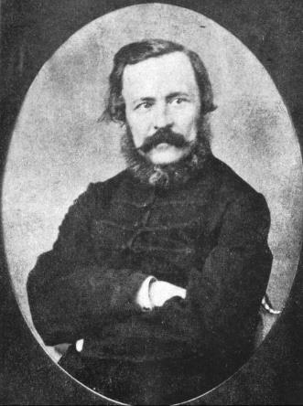
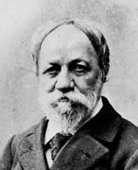



„Rendezni végre közös dolgainkat…”
Eötvös József
Jókai Mór
Mikszáth Kálmán
Móricz Zsigmond
„A harcot, amelyet őseink vivtak, békévé oldja az emlékezés s rendezni végre közös dolgainkat, ez a mi munkánk; és nem is kevés.”
József Attila: A Dunánál (1936)
1813-1871
1825-1904
1847-1910
1879-1947
A falu jegyzője
A Rab Rábi
A Noszty fiú este a
Tóth Marival
Rokonok

Slide 37
Az első lépés…
A paraszolvencián alapuló
„Megélhetési Medicína”
felszámolása
Kipipálva (?)
Megélhetés helyett a beteg kerülhessen a középpontba

Slide 38

Lehetetlen?
„A hajótörött legnagyobb tévedése, hogy sokat remél, és keveset tesz”

