Slide 1







Személyre szabott transzfúzió
Molnár Zsolt^{1,2,3,4}
¹Medical Director: CytoSorbents Europe, Berlin, Germany
²Institute for Translational Medicine, School of Medicine, University of Pécs, Hungary
³Department of Anaesthesiology and Intensive Therapy, Poznan University of Medical Sciences, Poznan, Poland
⁴Department of Anaesthesiology and Intensive Therapy, Markusovszky Teaching Hospital, Szombathely, Hungary

Slide 2
Treating anemia is controversial
Pros:
Increased risk of dying
After surgery
Cardiac disease
Critically ill
Carson JL, et al. Lancet 1996;348:1055-60.
Hébert PC, et al. Am J Respir Crit Care Med 1997;
155:1618-23.
Cons:
Complications
Immunological
Microcirculatory
van de Watering, et al. Circulation 1998;97:562-8.
Baker CH, et al. Circ Shock 1986;20:127-39.
Common sense: costly, limited resources

Slide 3
TRICC
N=838
7 vs 9 g/dL

Slide 4
TRISS
N=1005
7 vs 9 g/dL
Hb: 7 or 9?
a) It doesn’t matter
b) Restrictive is not inferior
We treat individuals and not a population

Slide 5
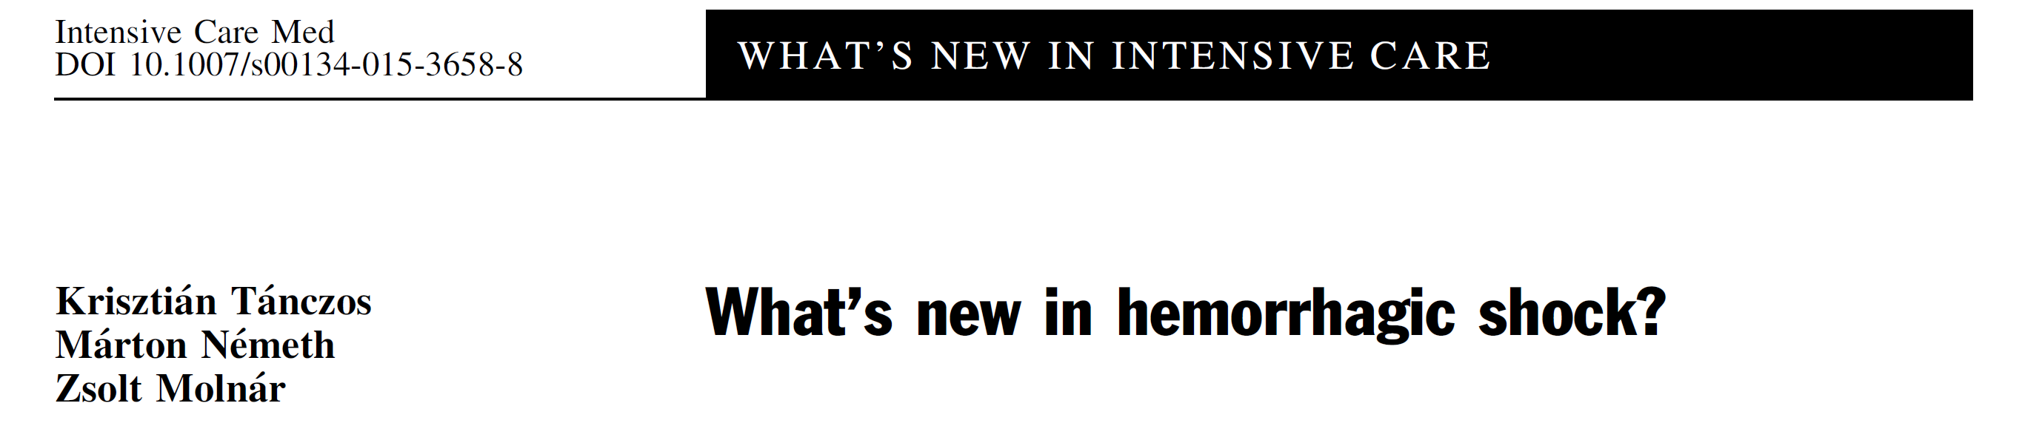
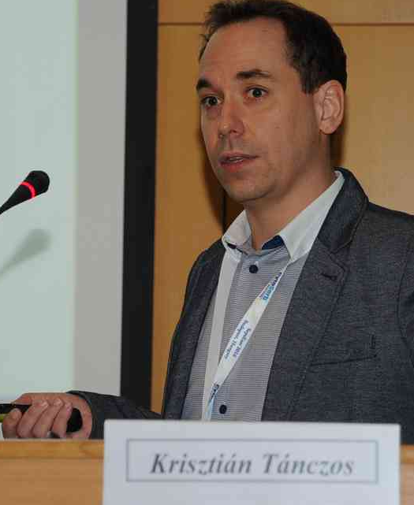
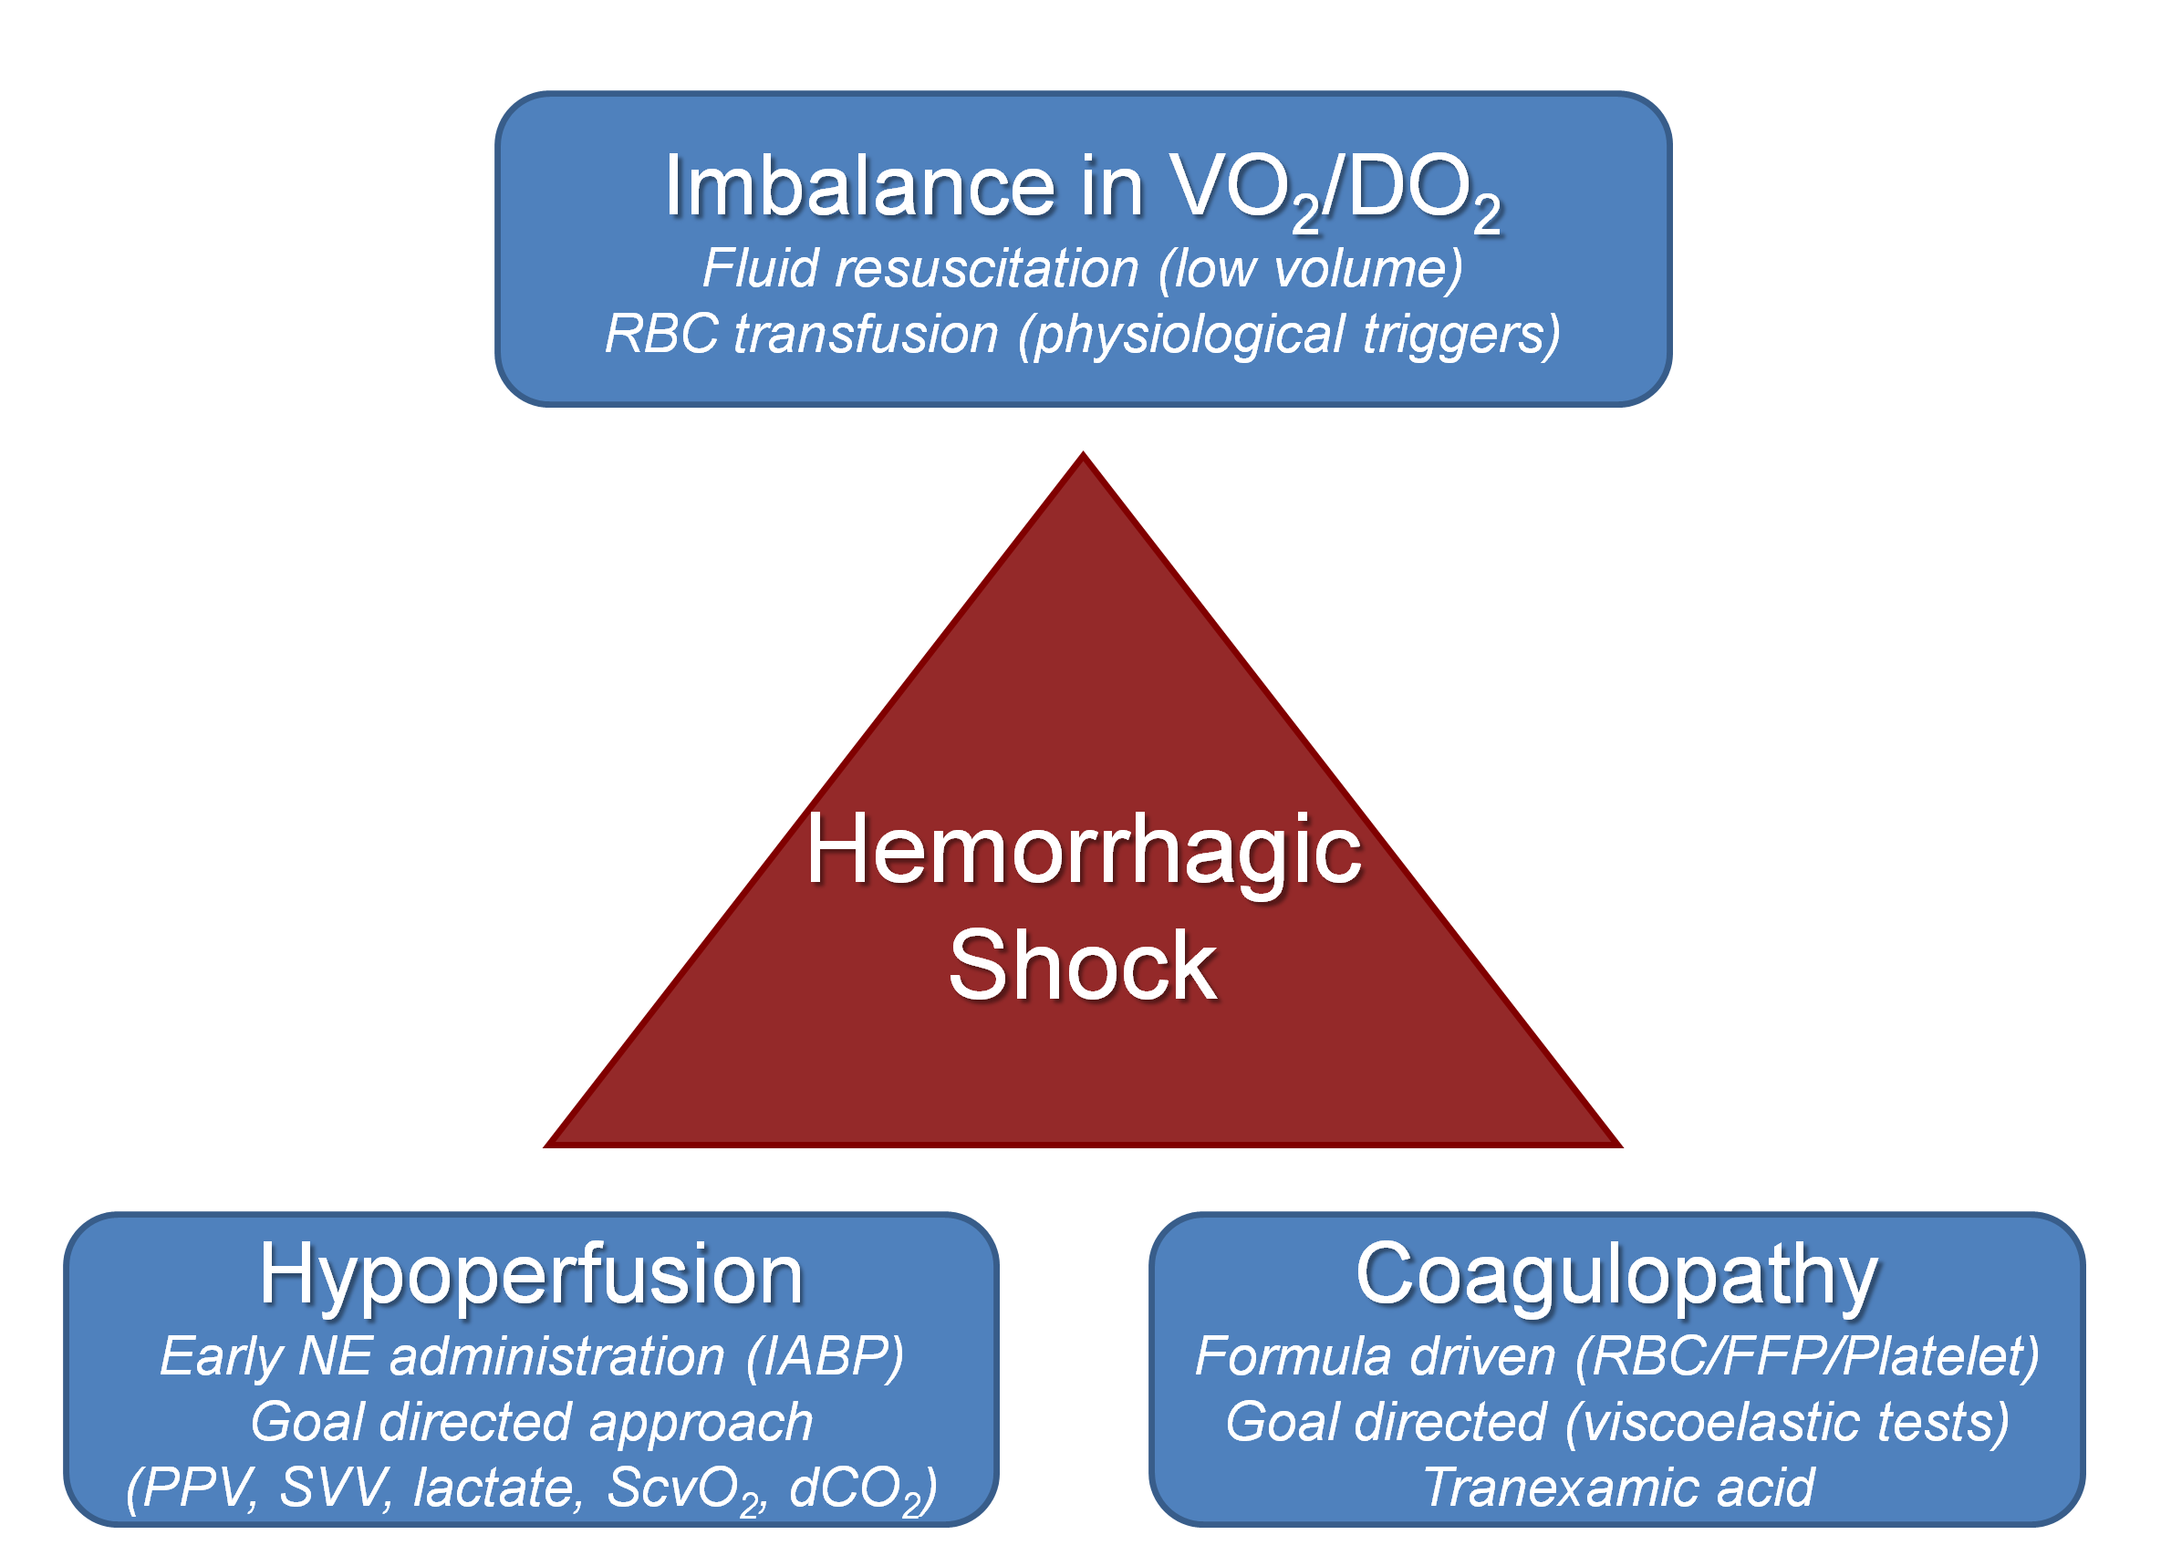


Slide 6
Miért adunk vért?

Slide 7
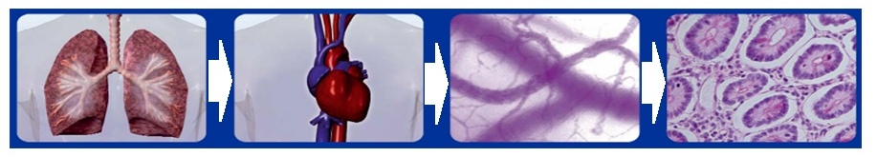
A adósság...
Fluid
Blood
Oxygen
DO₂= (SV•HR) • (Hb•1.39•SaO₂+0.003•PaO₂) ~ 1000ml/min
VO₂ = CO • (CaO₂ - CvO₂) ~ 300 ml/min
CO
CaO₂
Analgesia, sedation

Slide 8
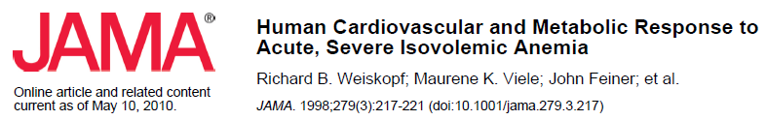
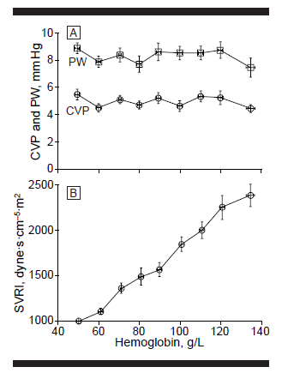
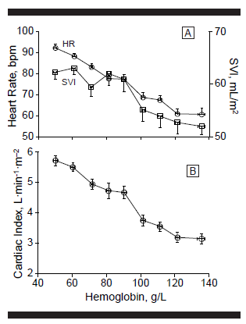

Slide 9
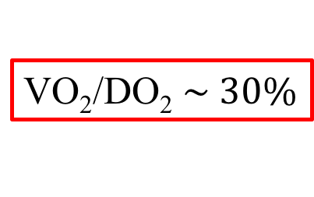
Reszuszcitációs lépések
SaO₂
~100%
ScvO₂
~70%
Fluid
Blood
Oxygen
DO₂= (SV•HR) • (Hb•1.39•SaO₂+0.003•PaO₂)
VO₂ = CO • (CaO₂ - CvO₂)
CO
CaO₂
Analgesia, sedation

Slide 10
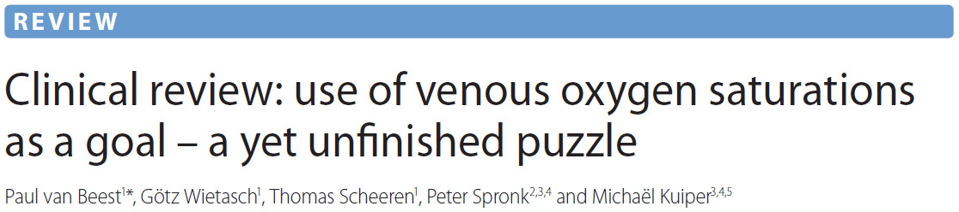
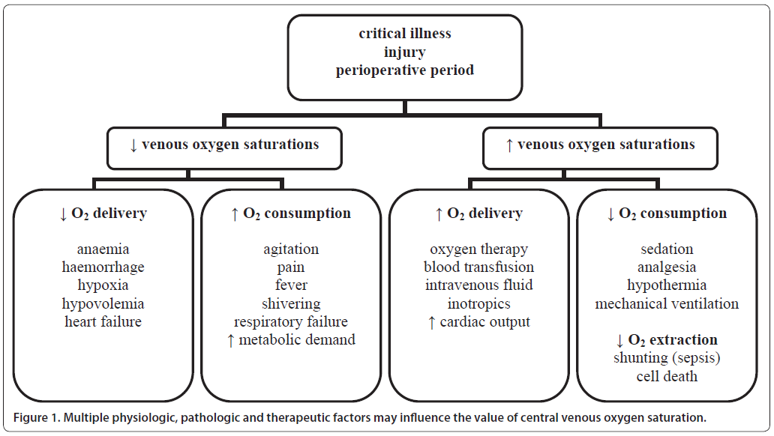
„…low venous saturations are an important warning sign for the inadequacy of DO₂ to meet oxygen demands.”

Slide 11
ScvO₂ and VO₂/DO₂
Critical point
DO₂
ScvO₂
VO₂ (ml/min)
Shock
DO₂ (ml/min)

Slide 12
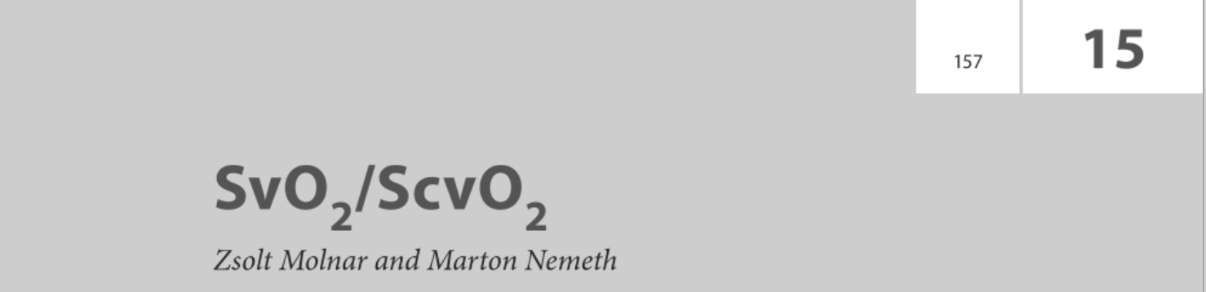
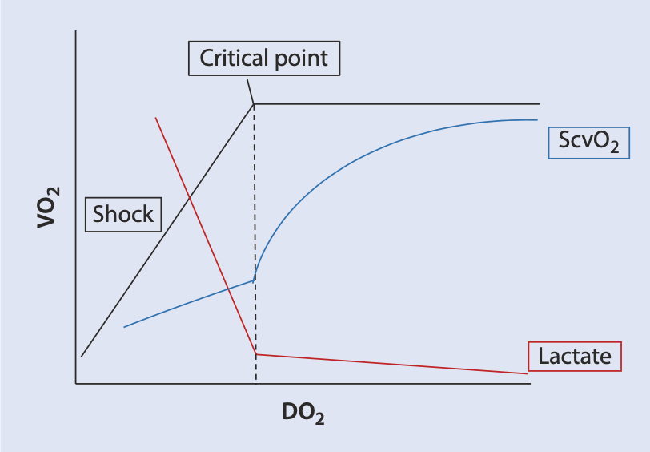

Slide 13
ScvO₂ – mint transzfúziós indikátor

Slide 14

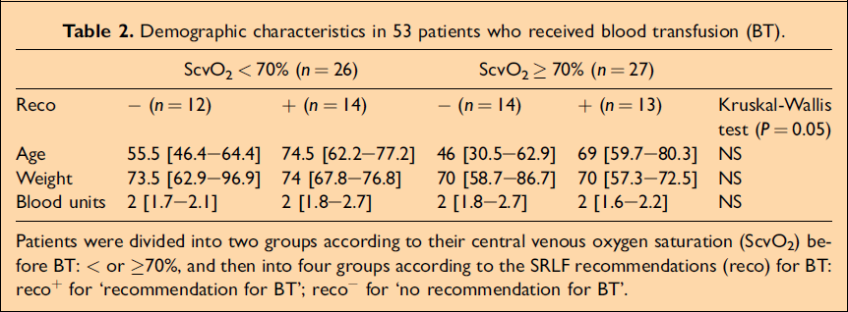
Vallet B, et al. BP&R Clin Anaesth 2007; 21: 173-181

Slide 15
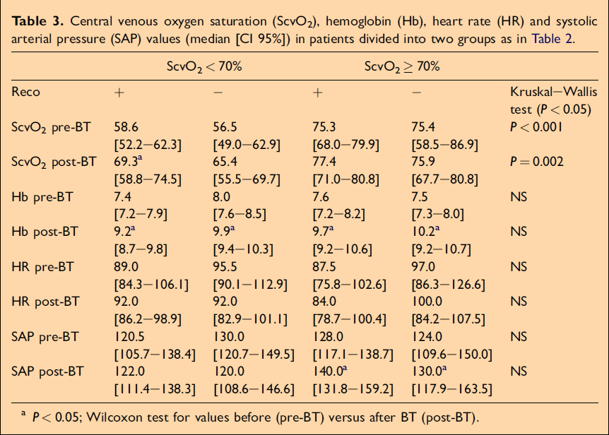
Vallet B, et al. BP&R Clin Anaesth 2007; 21: 173-181
The guideline was wrong?

Slide 16
CENTRAL VENOUS OXYGEN SATURATION (ScvO₂) – THE PHYSIOLOGIC TRANSFUSION TRIGGER?
Kocsi S, et al. Intensive Care Med 2010; 36(S2): S351
Median ScvO₂ = 71%
Low-group High-group
ScvO₂ <71% ScvO₂ ≥71%
 | Low (n = 27) | High (n = 23) | p
Heart rate (beats/min) | 90 (80-120) | 100 (89-110) | 0,981
MAP (mmHg) | 75 (69-91) | 80 (72-90) | 0,724
Se lactate (mmol/l) | 1,4 (0,9-3,4) | 0,9 (0,6-1,3) | 0,072
CVP (mmHg) | 10 (8-11) | 8 (4-10) | 0,041
Data are presented as: median (interquartile range).
For statistical analysis Mann-Whitney test was used. *, p<0.001

Slide 17
CENTRAL VENOUS OXYGEN SATURATION (ScvO₂) – THE PHYSIOLOGIC TRANSFUSION TRIGGER?
Kocsi S, et al. Intensive Care Med 2010; 36(S2): S351
 | Low ScvO₂-group (n=27) |  | High ScvO₂-group (n=23)
 | Before | After | Before | After
Hb (g/dl) | 7.6(7.0-8.2) | 9.2(8.2-9.8)* | 7.7(7.1-8.1) | 8.6(7.9-9.5)* #
ScvO₂ (%) | 62(57‑64) | 70(65‑72)* | 77(75‑81) | 80(76‑82)
O₂ER (%) | 37(33-51) | 28(20-35)* | 20(15‑24) | 20(15‑22)
Data are presented as: median (interquartile range).
For statistical analysis: comparing groups before-after Wilcoxon* and comparing Low-High groups Mann-Whitney# tests were used. *, p<0.001;#,p<0.001

Slide 18
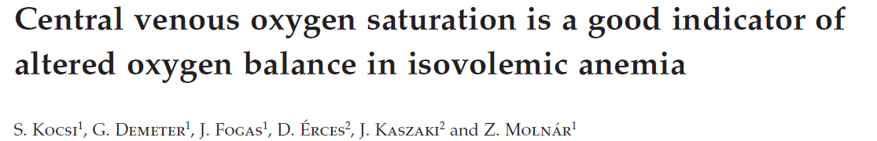


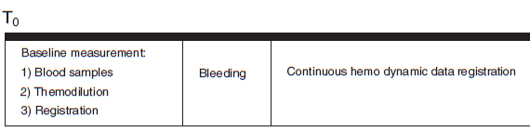
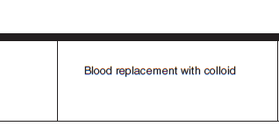
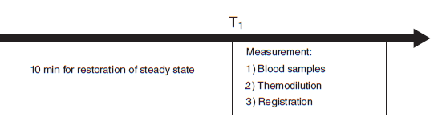
Acta Anaesthesiol Scand 2012; 56: 291–297

Slide 19
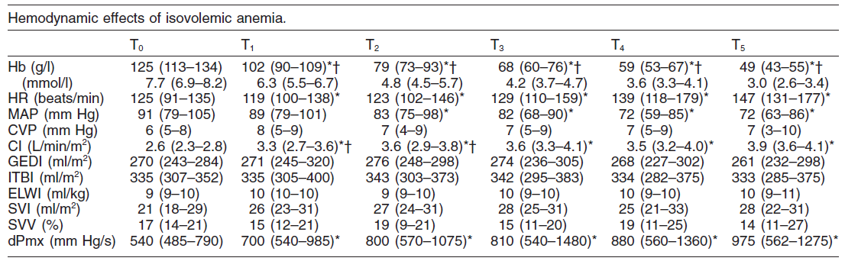
Acta Anaesthesiol Scand 2012; 56: 291–297
Decrease by 60%

Slide 20
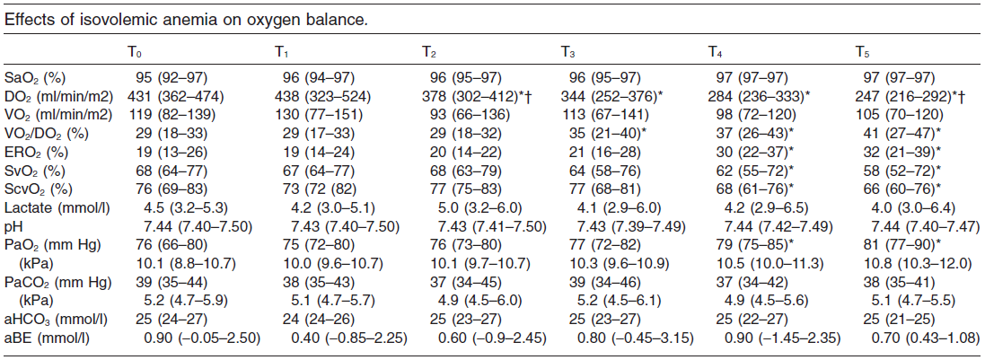
Acta Anaesthesiol Scand 2012; 56: 291–297
ScvO₂<70%
at Hb 59 g/l

Slide 21
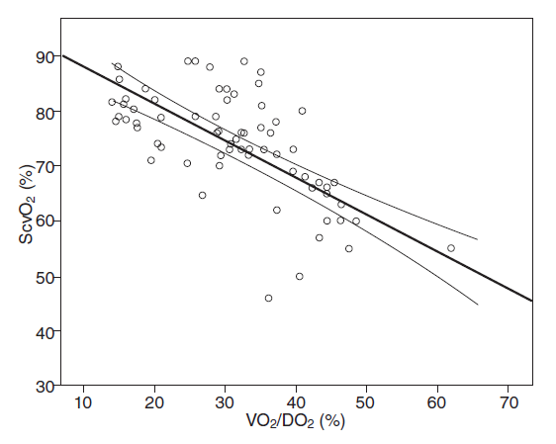
Acta Anaesthesiol Scand 2012; 56: 291–297
r = -0.71
p < 0.001

Slide 22
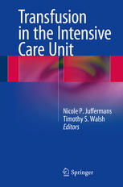
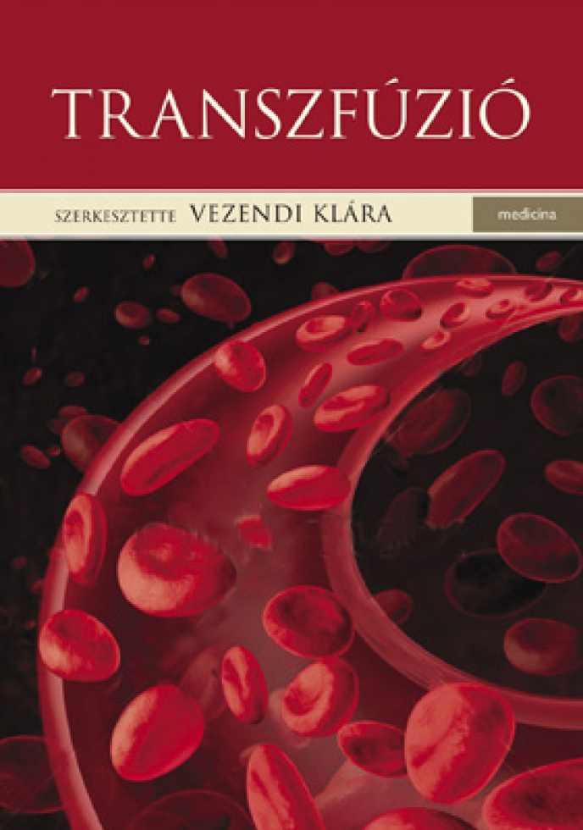
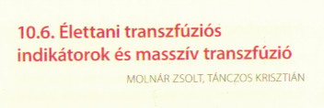
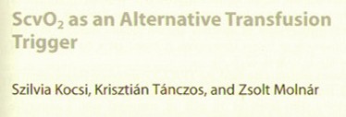
ScvO₂: a physiological transfusion trigger

Slide 24
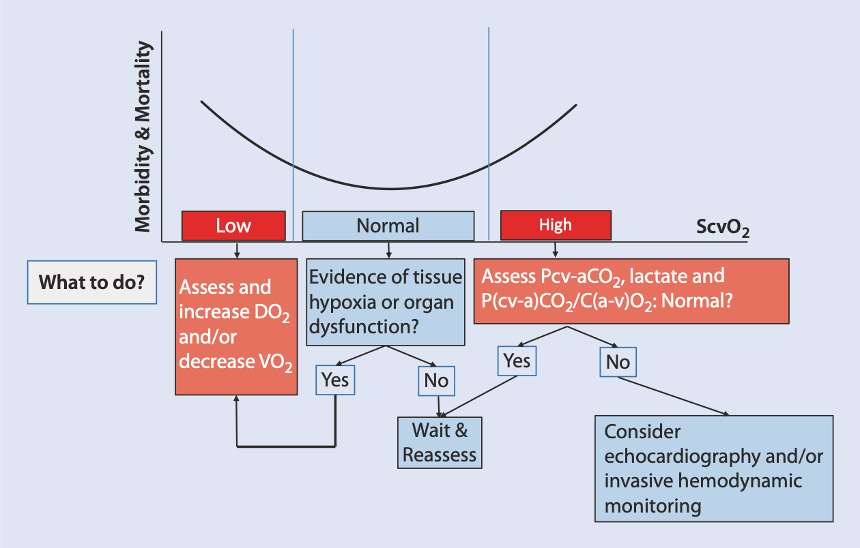

Slide 25
PRCT – on the way
Ennek sajnos annyi... ☹

Slide 26
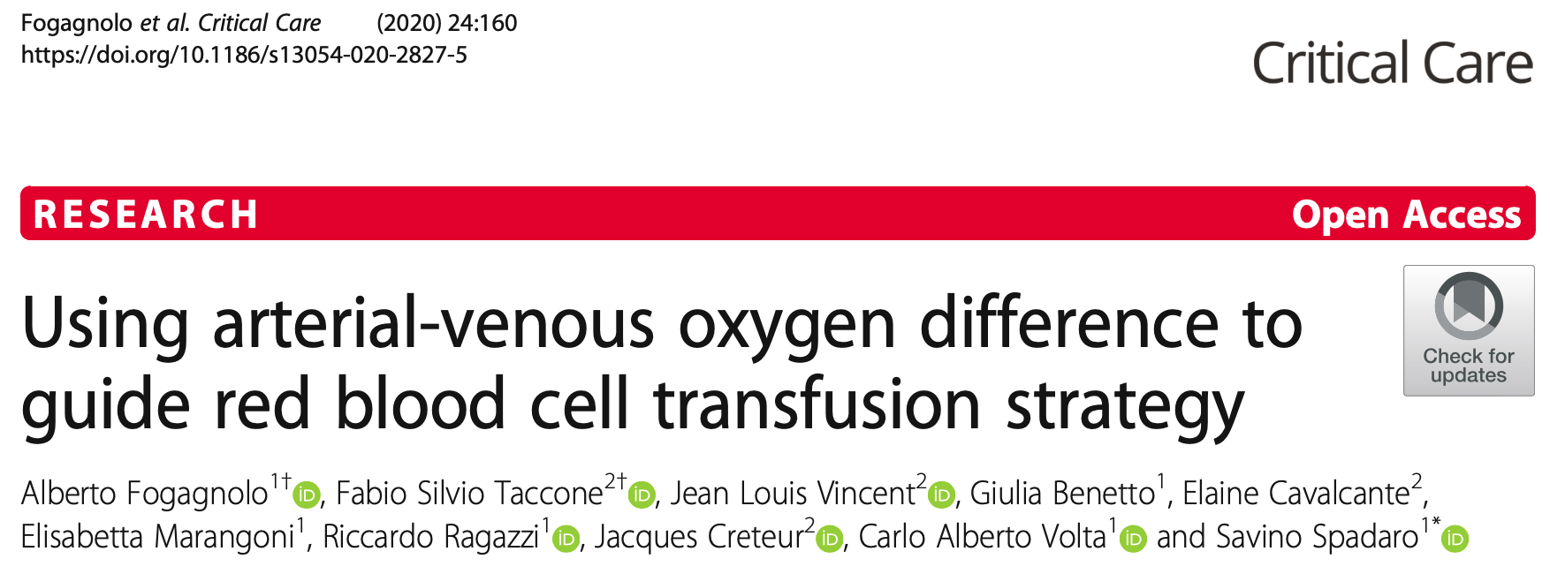
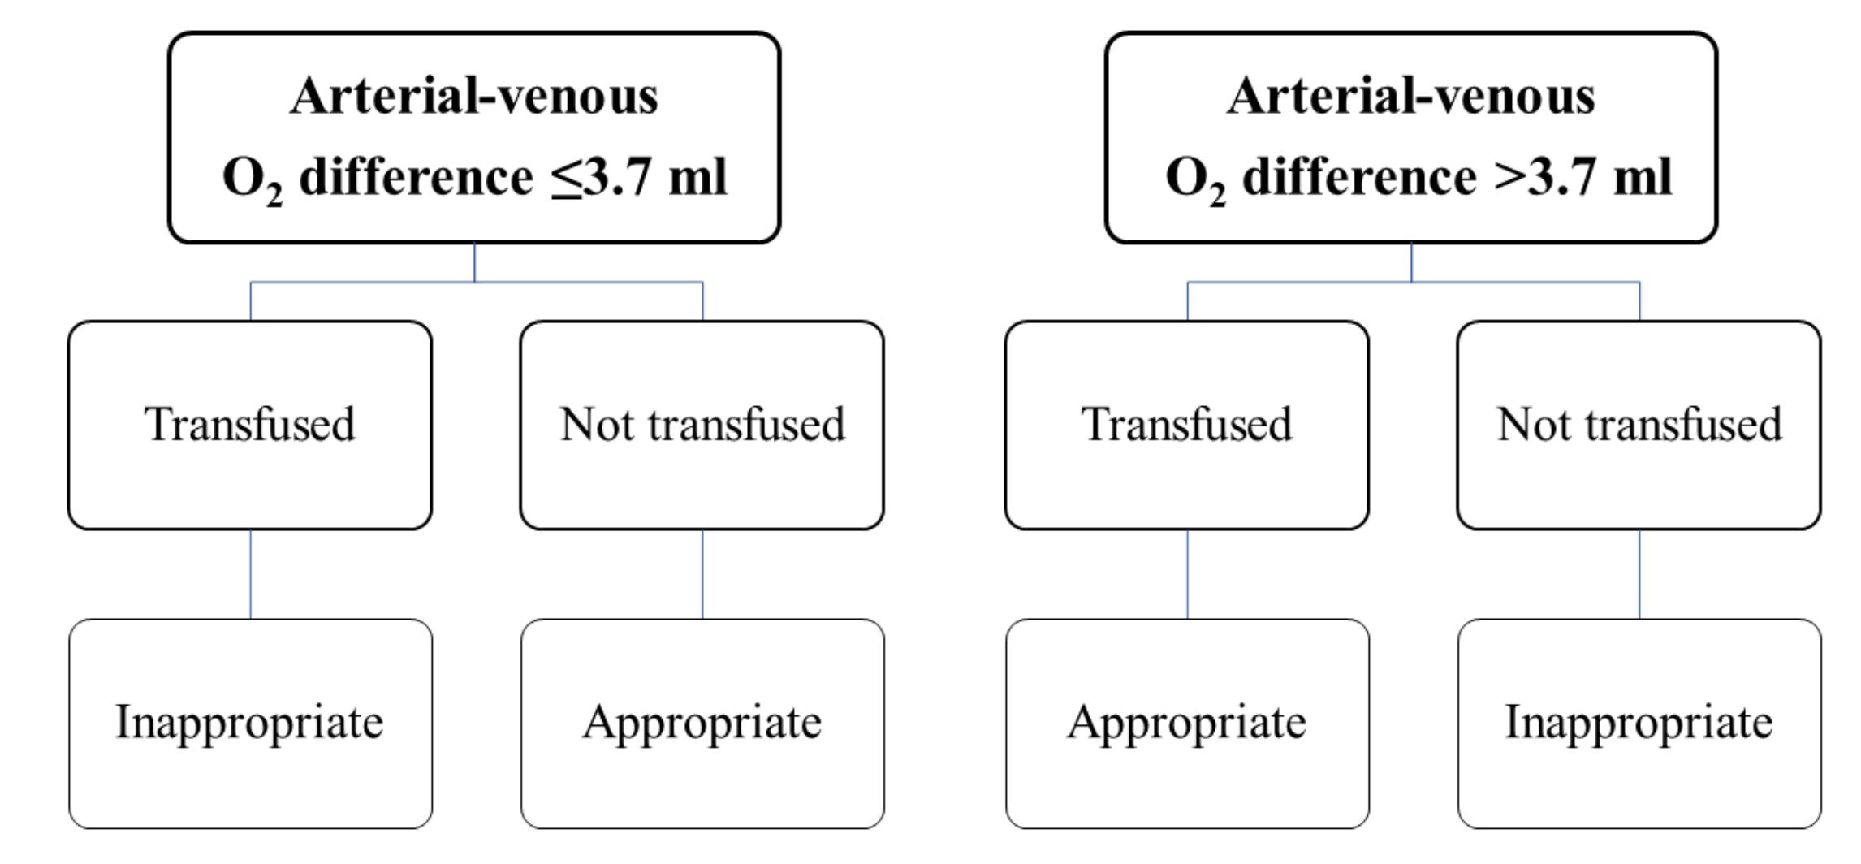

Slide 27
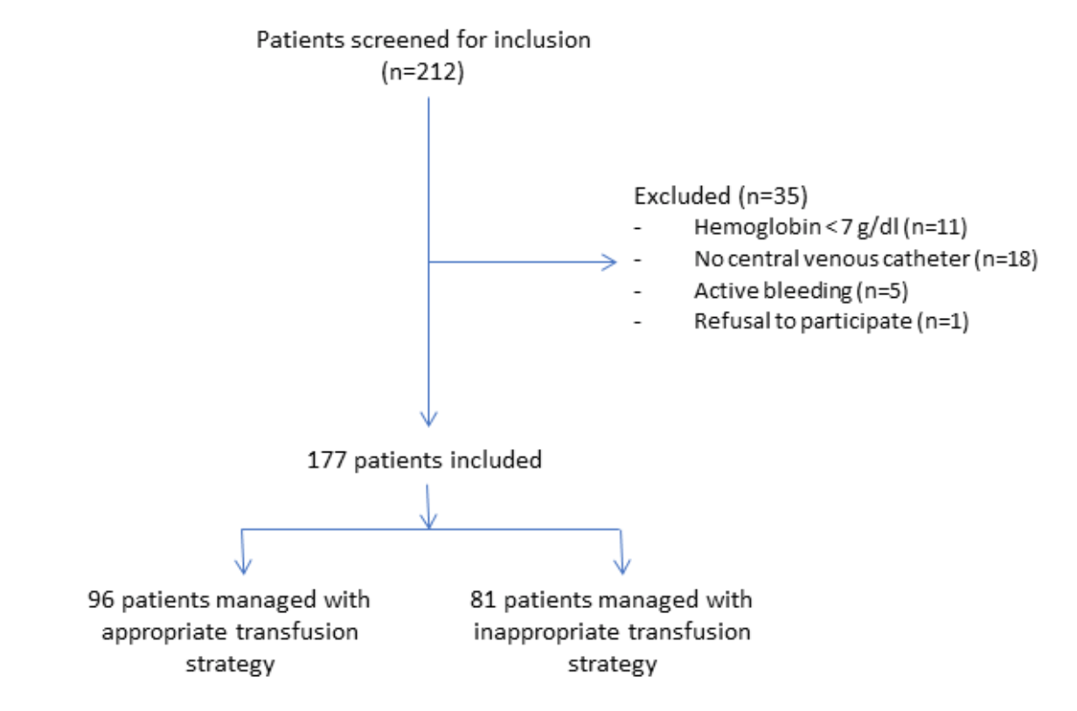
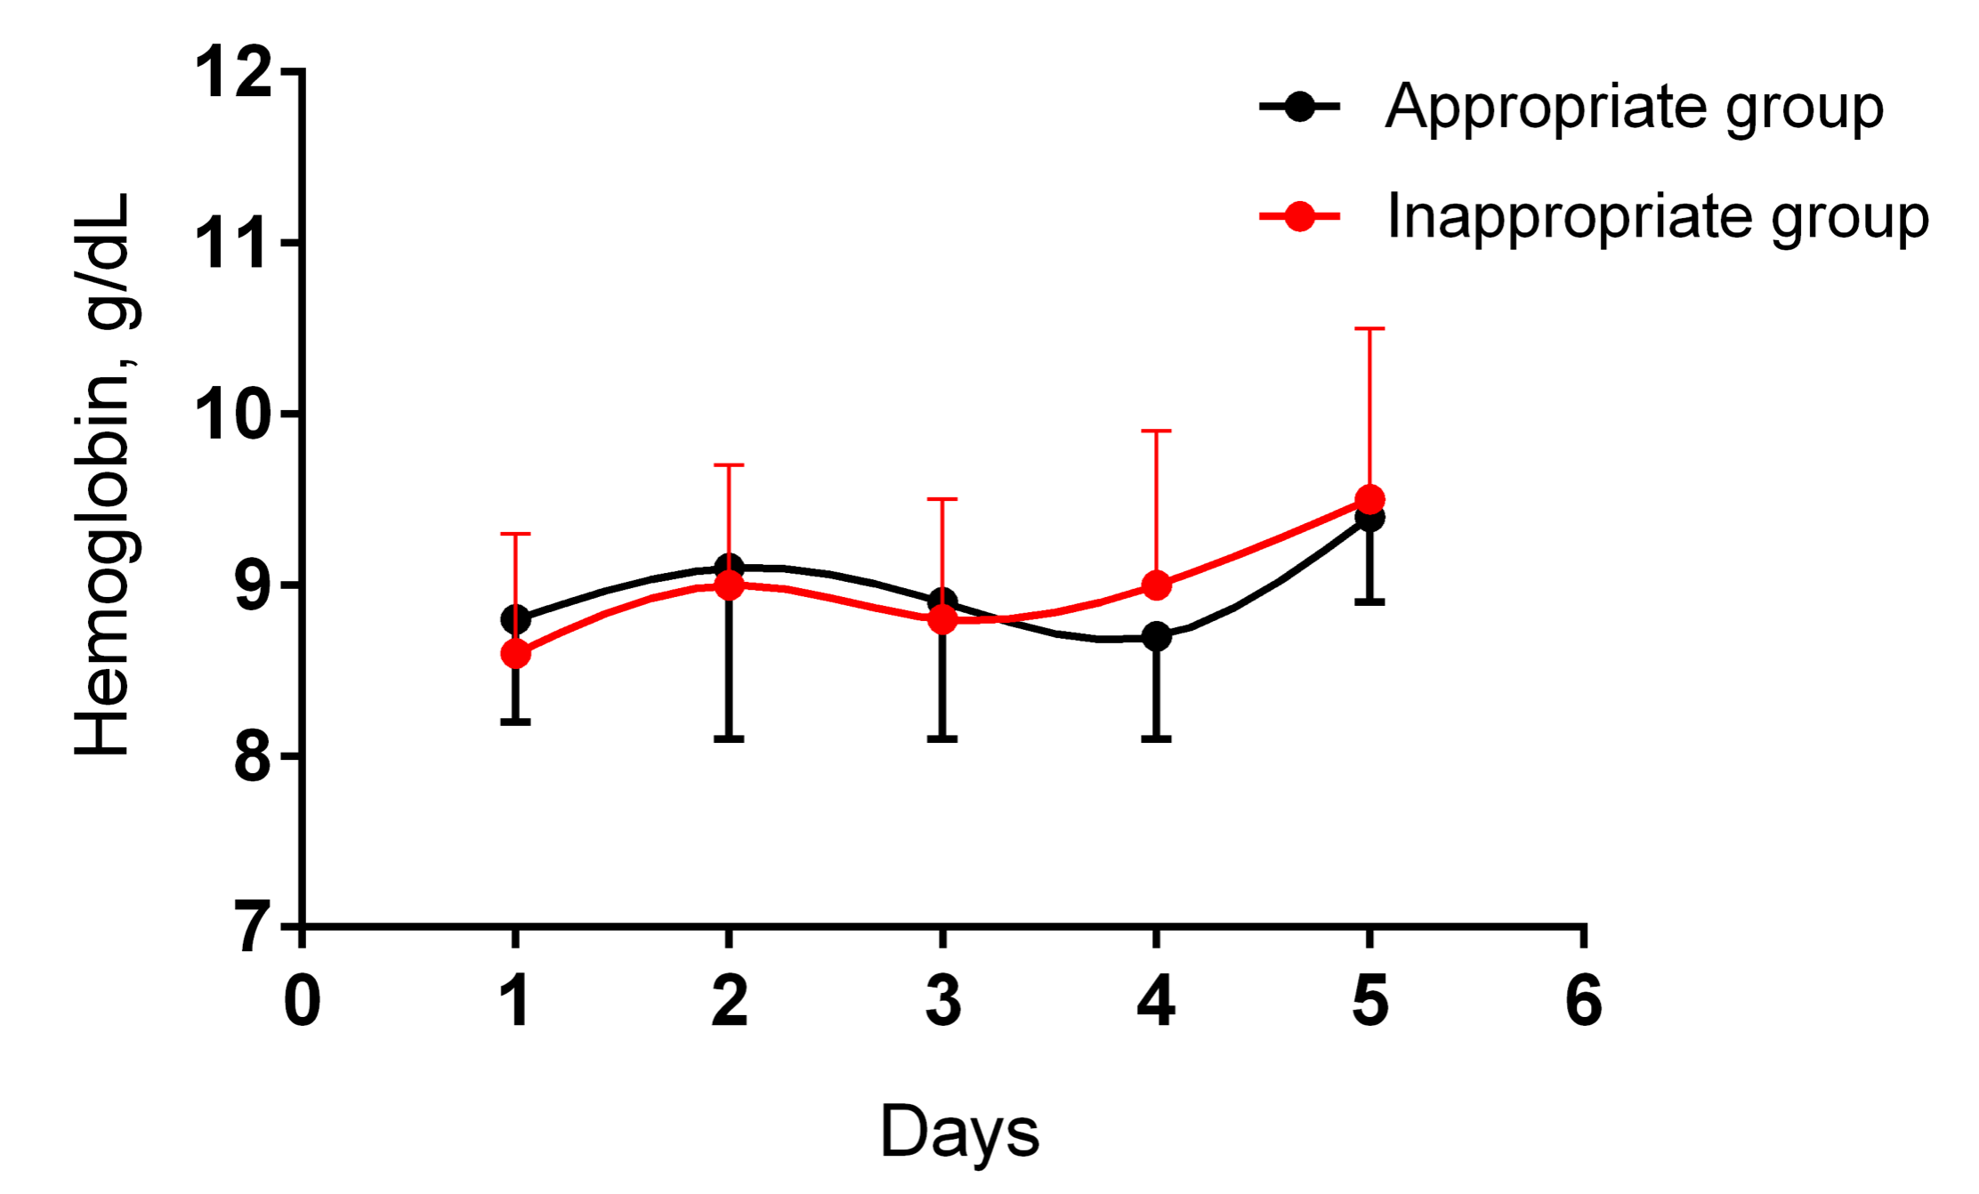

Slide 28
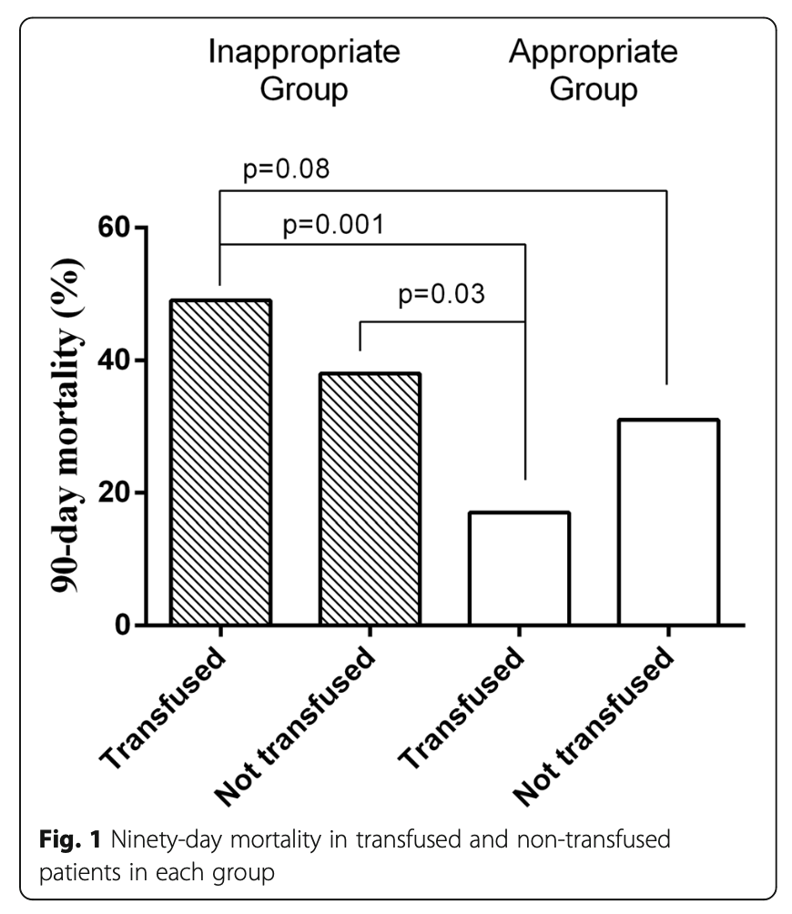
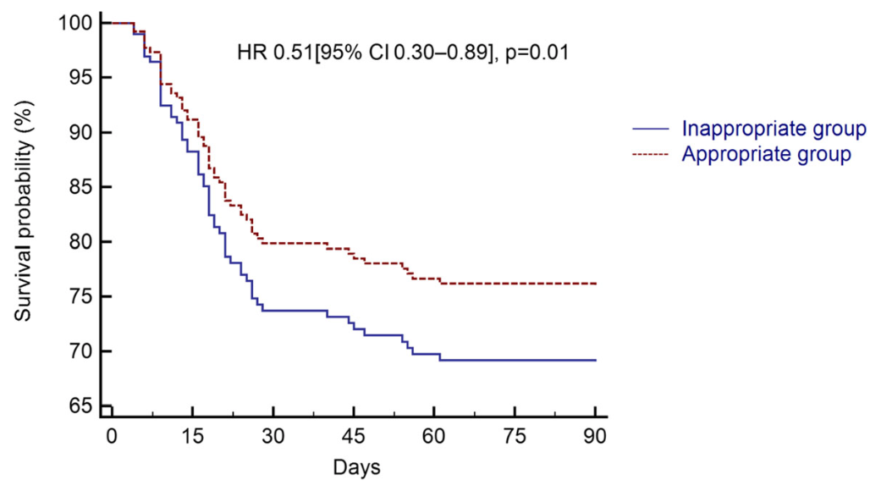
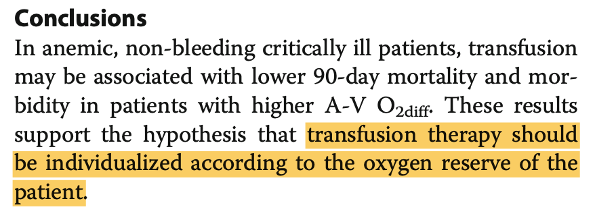

Slide 29
Folyadék reszuszcitáció - hemodilúció

Slide 30
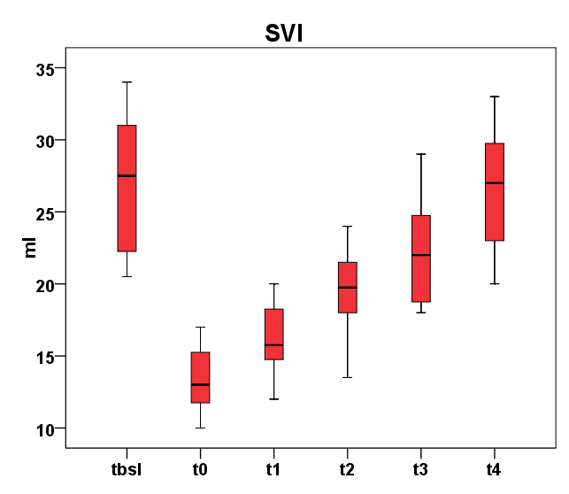
*
*
SVI drop by 50%
Resusc - SVI_{bsl}

Slide 31
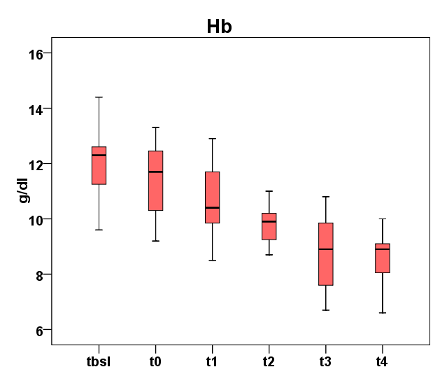
*
*
During fluid resuscitation
significant hemodilution takes place
SVI drop by 50%
Resusc - SVI_{bsl}

Slide 32
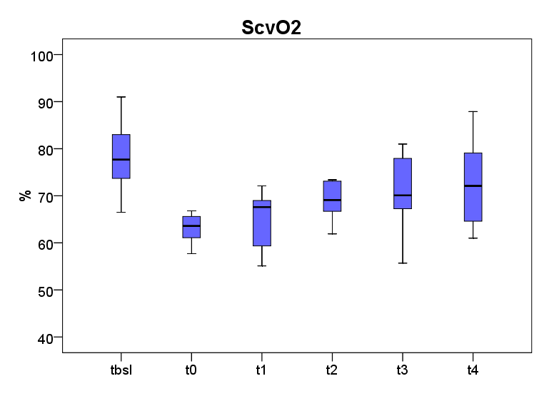
*
*
*
*
ΔScvO₂~5%
Don’t use baseline ScvO₂ as target end-point for resuscitation
SVI drop by 50%
Resusc - SVI_{bsl}

Slide 33
How to put all that into clinical practice?

Slide 34
Case history
64 year old man
    Car accident
    Multiple trauma
    Pelvic, rib fractures
    PMH: hypertension, diabetes
Transfered to the ICU after surgery
    Mechanical ventilation
    Routine monitoring

Slide 35
Postoperative day 3. 9:00 a.m.
    Circulation Respiratory Function
    Arterial BG Central venous BG
Heart rate (min-1) | 98
MAP (mmHg) | 70
Hb (g/dl) | 7.2
Noradrenaline | -
FiO₂ | 0.5
PEEP | 8 cmH₂O
PaO₂ | 96 mmHg
pH | 7.34
pCO₂ (mmHg) | 46
HCO₃ (mmol/l) | 26
Lactate (mmol/l) | 1.9
pCO₂ | 50mmHg
P(v-a)CO₂ | 4 mmHg
ScvO₂ | 73 %

Slide 36
Postoperative day 3. 9:00 a.m.
Would you transfuse?
    Circulation Respiratory Function
    Arterial BG Central venous BG
Heart rate (min-1) | 98
MAP (mmHg) | 70
Hb (g/dl) | 7.2
Noradrenaline | -
FiO₂ | 0.5
PEEP | 8 cmH₂O
PaO₂ | 96 mmHg
No - there is time to wait
pH | 7.34
pCO₂ (mmHg) | 46
HCO₃ (mmol/l) | 26
Lactate (mmol/l) | 1.9
pCO₂ | 50mmHg
P(v-a)CO₂ | 4 mmHg
ScvO₂ | 73 %

Slide 37
Postoperative day 3. 2:00 p.m. - weaning
    Circulation Respiratory Function
    Arterial BG Central venous BG
Heart rate (min-1) | 98
MAP (mmHg) | 70
Hb (g/dl) | 7.2
Noradrenaline | -
FiO₂ | 0.5 (on T-piece)
PEEP | 5 cmH₂O
PaO₂ | 88 mmHg
pH | 7.34
pCO₂ (mmHg) | 46
HCO₃ (mmol/l) | 26
Lactate (mmol/l) | 1.9
pCO₂ | 50mmHg
P(v-a)CO₂ | 4 mmHg
ScvO₂ | 65%

Slide 38
Postoperative day 3. 2:00 p.m. - weaning
Would you transfuse?
    Circulation Respiratory Function
    Arterial BG Central venous BG
Heart rate (min-1) | 98
MAP (mmHg) | 70
Hb (g/dl) | 7.2
Noradrenaline | -
FiO₂ | 0.5 (on T-piece)
PEEP | 5 cmH₂O
PaO₂ | 88 mmHg
Yes!
pH | 7.34
pCO₂ (mmHg) | 46
HCO₃ (mmol/l) | 26
Lactate (mmol/l) | 1.9
pCO₂ | 50mmHg
P(v-a)CO₂ | 4 mmHg
ScvO₂ | 65%

Slide 39
Instead of summary

Slide 40
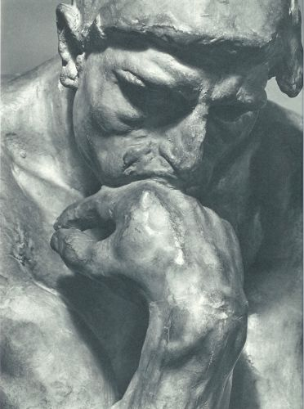
The best transfusion indicator:
Auguste Rodin: The Thinker

