Slide 1







Amiről a vérgáz mesél... Molnár Zsolt^{1,2,3,4} ¹CytoSorbents Europe, Berlin, Germany ²Institute for Translational Medicine, School of Medicine, University of Pécs, Hungary ³Department of Anaesthesiology and Intensive Therapy, Poznan University of Medical Sciences, Poznan, Poland ⁴Department of Anaesthesiology and Intensive Therapy, Markusovszky Teaching Hospital, Szombathely, Hungary

Slide 2
Alapok

Slide 3
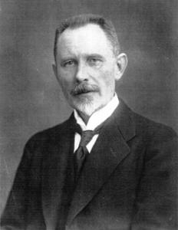
Potency of H⁺
H⁺ nmol/L
H⁺ potency: pH (pondus Hydrogenii)
Søren Sørensen, 1909
pH = -lg H⁺
-lg 40 = 7.40
40

Slide 4
Potency of H⁺
H⁺ nmol/L
H⁺ potency: pH (pondus Hydrogenii)
Søren Sørensen, 1909
pH = -lg [H⁺]
-lg 40 = 7.40
-lg 100 = 7.00
-lg 16 = 7.80
100
pH:7.00
40
pH:7.41
16
pH:7.80

Slide 5
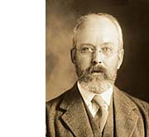
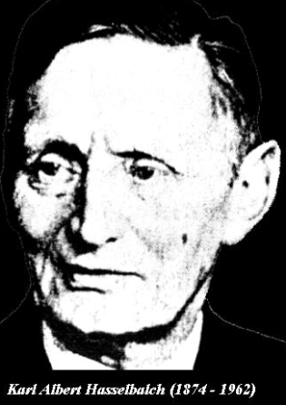


Henderson-Hasselbalch
Lawrence Joseph Henderson
Harvard: physiologist, chemist, biologist, filosophers, sociologist
1906-ban leírja a sav-bázis-puffer rendszerek viszonyát: K = [H⁺] [HCO₃⁻] / [dCO₂]
Karl Albert Hasselbalch
Coppenhagen: physicist, chemist
1916 applies Henderson’s equation
Introduces the term: „standardized pH”

Slide 6
Vérgázelemzés

Slide 7
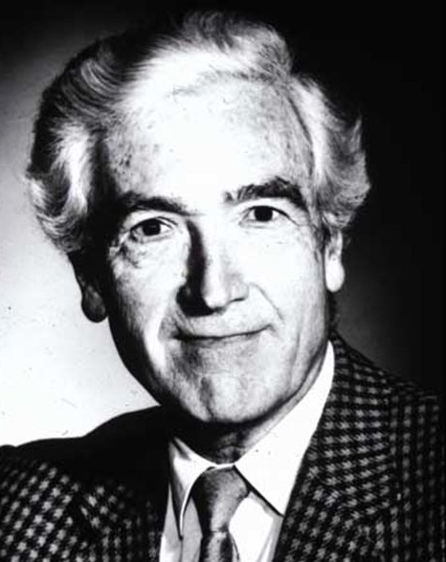
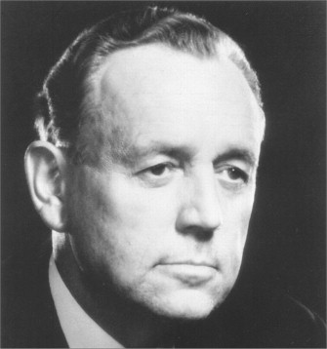
History
Birth of intensive care and the blood gas analyser
1952 Coppenhagen: polio-epidemic
Blegdamshospital
31 patients – 21 dead within 72 hrs
Bjorn Ibsen (1915-2007)
Poul Astrup (1915-2000)
Lassen HCA. 1956. Management of poliomyelitis. In HCA Lassen Management of life threatening poliomyelitis. Copenhagen, 1952-1956: With a survey of autopsy findings in 115 cases. E.S. Livingstone Ltd, London

Slide 8
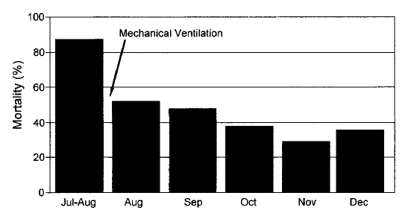
Saving lives in 1952
60%!!!
Lassen HC. A preliminary report on the 1952 epidemic of poliomyelitis in Copenhagen with special reference to the treatment of acute respiratory insufficiency. Lancet 1953;1(1):37–41.

Slide 9
What does an ABG tell us?
pH
PaCO₂
actHCO₃⁻
stHCO₃⁻
BE
BB
- measured: 7.35-7.45
- measured: 35-45 Hgmm
- calc: 22-24 mmol/L
- calc: (T, CO₂) 21-28 mmol/L
- c: (T, CO₂, pH) ±3 mmol/L
- c: ~48 mmol/l

Slide 10
Scandinavian vs. Boston school
Scandinavian school
Sörensen, Astrup, Siggaard-Andersen
BE, BB
Boston school
Henderson, Schwartz WB, Relman AS
Use what is measured
pH, CO₂, HCO₃⁻

Slide 11
Algorithm
H⁺ concentration: pH
> 7.45 = alkalosis
< 7.35 = acidosis
7.35 < pH < 7.45 = normal v. compensated
Respiratory component: PaCO₂
> 45 Hgmm = respiratory acidosis
< 35 Hgmm = respiratory alkalosis
Metabolic component: HCO₃⁻
> 25 mmol/L = metabolic alkalosis
< 20 mmol/L = metabolic acidosis
Compensated changes
1/c + 2/a + 3/a = respiratory acidosis
1/c + 2/b + 3/b = metabolic acidosis

Slide 12
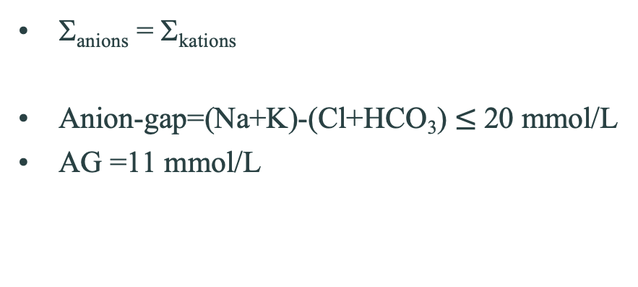
Concept of electroneutrality
Σ+ = 154
Σ- = 154 mmol/L
Σ_{anions} = Σ_{kations}
Anion-gap=(Na+K)-(Cl+HCO₃) $≤$20 mmol/L
AG =11 mmol/L
Na⁺ = 142
Cl⁻ = 109
K⁺ = 4
Mg²⁺ = 2
Ca²⁺ = 5
Misc = 1
HCO₃ = 26
Organic acids = 6
Protein = 16
HPO₄ = 2
SO₄ = 1

Slide 13
Metabolikus acidózis = alacsony HCO₃
Σ+ = 154
Σ- = 154 mmol/L
High AG
AG = 21 mmol/L
Na⁺ = 142
Cl⁻ = 109
HCO₃ = 26
Organic acids = 6
Protein = 16
HPO₄ = 2
SO₄ = 1
K⁺ = 4
Mg²⁺ = 2
Ca²⁺ = 5
Misc = 1
16
16

Slide 14
Metabolikus acidózis = alacsony HCO₃
Σ+ = 154
Σ- = 154 mmol/L
AG = 11 mmol/L
Normal AG
Cl⁻ = 109
Na⁺ = 142
119
HCO₃ = 26
Organic acids = 6
Protein = 16
HPO₄ = 2
SO₄ = 1
K⁺ = 4
Mg²⁺ = 2
Ca²⁺ = 5
Misc = 1
16

Slide 15
Leggyakoribb sav-bázis zavarok

Slide 16
Metabolic acidosis
High AG
Lactate acidosis: shock, sepsis, liver failure, etc
Ketoacidosis
Acid intake: salicilate toxicity
Normal AG
Intestinal HCO₃⁻ loss: diarrhea, fistula stb.
Renal HCO₃⁻ loss: RTA

Slide 17
Metabolic alkalosis
Acid loss
NG aspirate
Diuretics - hypokalemia
Excessive alkalinization
HCO₃⁻
Citrate, lactate (Ringer), acetate

Slide 18
Respiratory acidosis
Altered level of consciousness
Overdose: opiates, sedatives
Trauma: head, i.c. bleeding
Muscle weakness
Guillain-Barré, myastenia, muscle relaxant effect
Type II respiratory failure
COPD, acute exacerbation
Inadequate IPPV

Slide 19
Respiratory alkalosis
Pulm. emb.
CNS excitation
Meningitis, encephalitis
I.c. bleeding
Asthma
Iatrogen
Inadequate IPPV

Slide 20
Mixed disorders
Acidosis
Shock: septic, cardiogen+pulm oedema
St. post CPR
Alkalosis
Hyperventilation + NG aspirate (vomiting)
Liver failure + diuretics

Slide 21
Vénás vérgáz

Slide 22
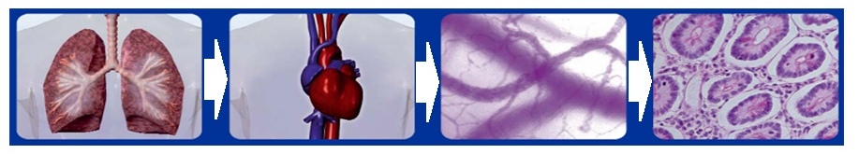
Reszuszcitációs lépések
Fluid
Blood
Oxygen
DO₂= (SV•HR) • (Hb•1.39•SaO₂+0.003•PaO₂)
VO₂ = CO • (CaO₂ - CvO₂)
CO
CaO₂
Analgesia, sedation

Slide 23
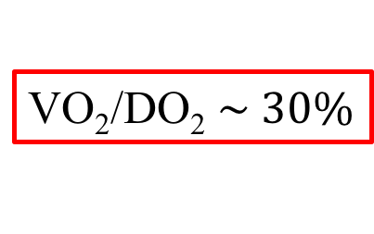
Reszuszcitációs lépések
SaO₂
~100%
ScvO₂
~70%
Fluid
Blood
Oxygen
DO₂= (SV•HR) • (Hb•1.39•SaO₂+0.003•PaO₂)
VO₂ = CO • (CaO₂ - CvO₂)
CO
CaO₂
Analgesia, sedation

Slide 24
Alapállás
Critical point
DO₂
ScvO₂
VO₂ (ml/min)
Shock
DO₂ (ml/min)

Slide 26
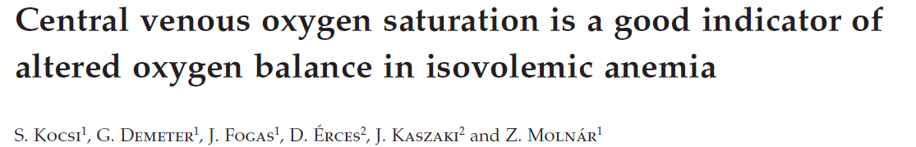

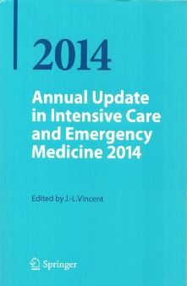
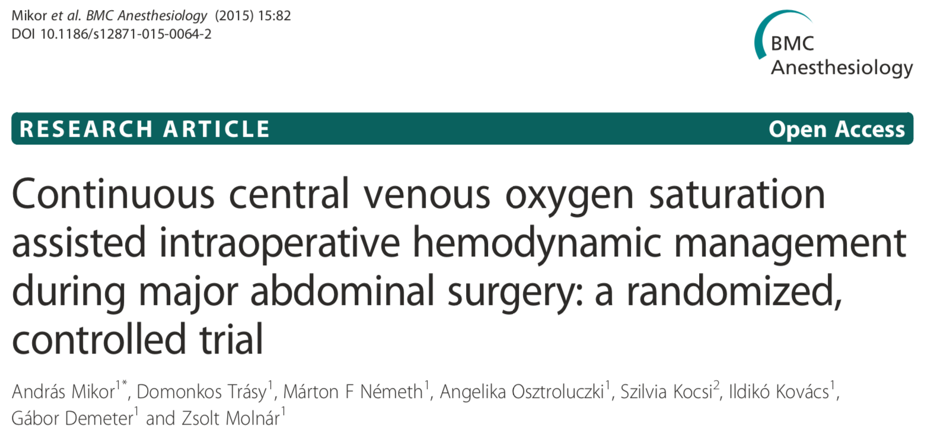
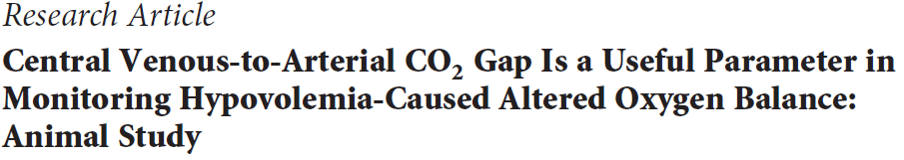

Clinical application of ScvO₂
Acta Anaesthesiol Scand 2012; 56: 291–297
PLoS ONE 2014; 9(8): e105148. doi:10.1371/journal.pone.0105148
Kocsi Sz, Tánczos K, Molnár Z. 2015, pp:71
Tánczos K, Németh M, Molnár Z. 2014, pp:355

Slide 27
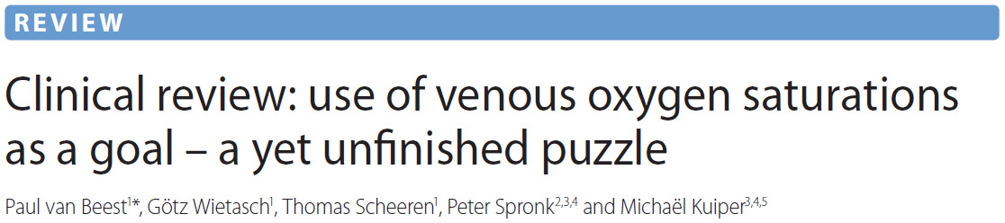
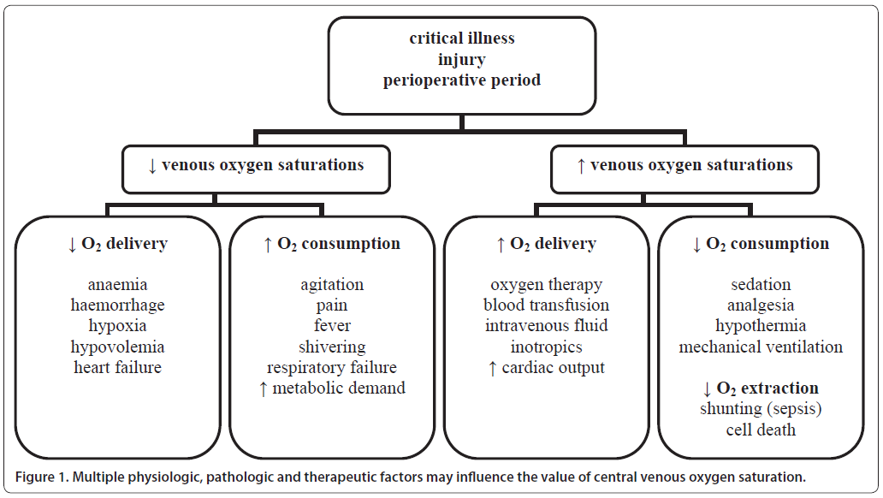
„…low venous saturations are an important warning sign for the inadequacy of DO₂ to meet oxygen demands.”

Slide 28
Példák

Slide 29
Case - 1
48 y old woman, admitted with shock: BP 90/50, HR 130, Dg: UTI
pH: 7.36
pCO₂: 29
HCO₃: 16
Dg: compensated metabolic acidosis
Treatment:
O₂, fluid, vasopressors, AB

Slide 30
Case - 2
53 y old man, cirrhotic, bleeding from eoph. varices: BP 70/.., HR 130
pH: 7.28
pCO₂: 33
HCO₃: 17
K: 5.4
Dg: decompensated metabolic acidosis
Treatment:
O₂, fluid, blood, endoscopy+ligation

Slide 31
Case - 3
53 y old man, IDDM, admitted with coma (GCS:7)
pH: 7.05
CO₂: 23
HCO₃⁻: 6.5
Dg: severe decompensated metabolic acidosis
Treatment:
ETT-O₂, fluid (LR +/- bicarb), insulin i.v. bolus+cont.

Slide 32
Case - 4
68 y old man, colon cancer, postop day 3, unwell, GCS: 12
pH: 7.60
CO₂: 43
HCO₃⁻: 43
Dg: decompensated metabolic alkalosis
Treatment:
O₂, fluid (RL), K⁺ (max: 50 mmol/h)

Slide 33
Case - 5
70 y old man, COPD, admitted with acute flareup of cold
pH: 7.48
CO₂: 72
HCO₃⁻: 54
Dg: compensated respiratory acidosis
Treatment:
O₂, fluid (RL), observation on medical ward, ?AB

Slide 34
Case - 6
75 y old man, COPD, admitted with vomiting+diarrhoea for days
pH: 7.24
CO₂: 72
HCO₃⁻: 28
Na⁺: 148
K⁺: 5.7
Cl⁻: 96
AG: 29.7
Lac: 3.5
Dg: decompensated metabolic acidosis
Treatment:
O₂, fluid (RL), ?dialysis, ?AB

Slide 35
Case - 7
62 y old woman, post op acute gastric perforation
pH: 7.57
CO₂: 26
HCO₃⁻: 24
Dg: decompensated respiratory alkalosis
Treatment:
O₂, morphine+ whatever

Slide 36
Case - 8
17 y old girl, admitted from a disco in coma, otherwise stable:
pH: 7.06
CO₂: 80
HCO₃⁻: 25
Dg: decompensated respiratory acidosis
Treatment:
ETT, ?antidote, …give her time

Slide 37
Case: 8+1
69 y FM
IDDM, hypertension
3 days vomiting, diarrhea
Admitted 1 day ago – medicine, UTI?
Therapy: AB

Slide 38
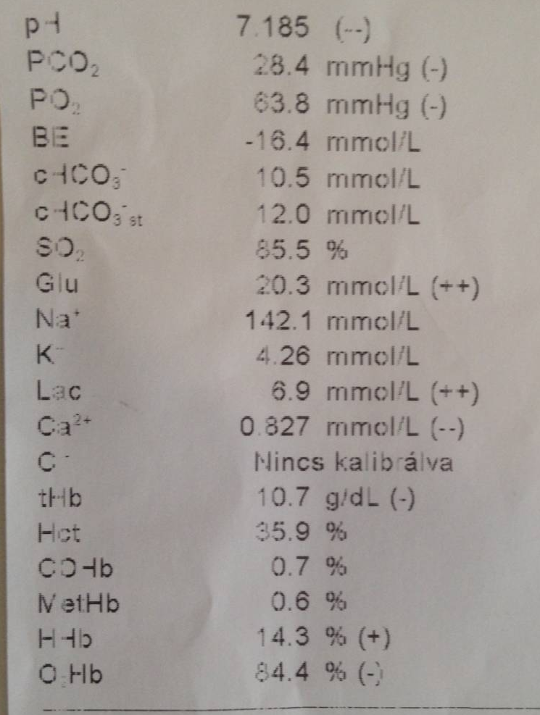
ICU referral 13:45
pH: 7.185
pCO2: 28.4
HCO3: 10.5
Lactate: 6.9

Slide 39
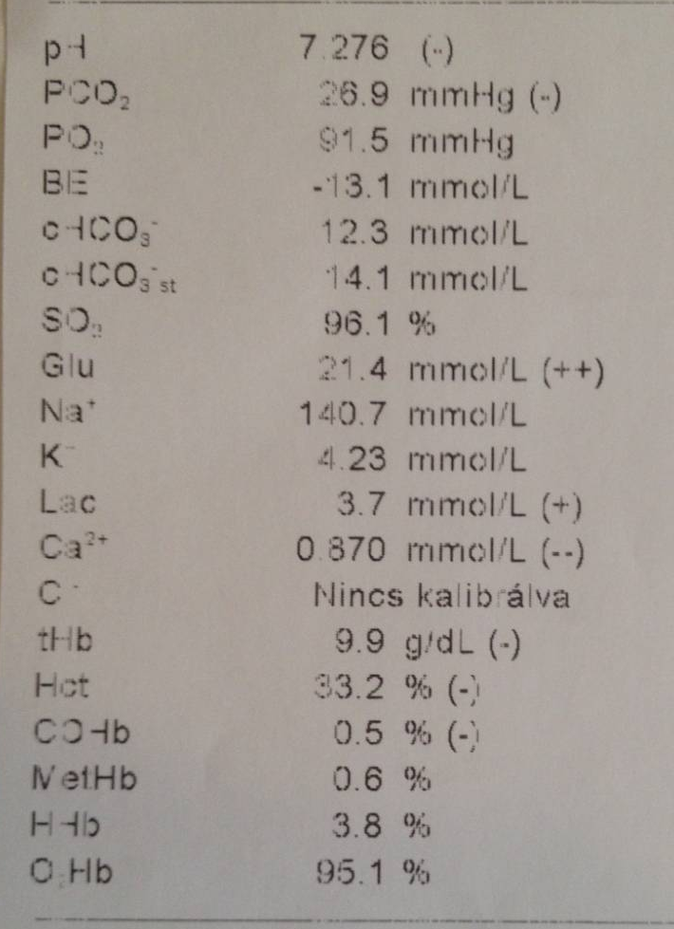
ICU admission 14:00
Oxygen + 500 ml RL
↑pH
↑HCO3
↓Lactate

Slide 40
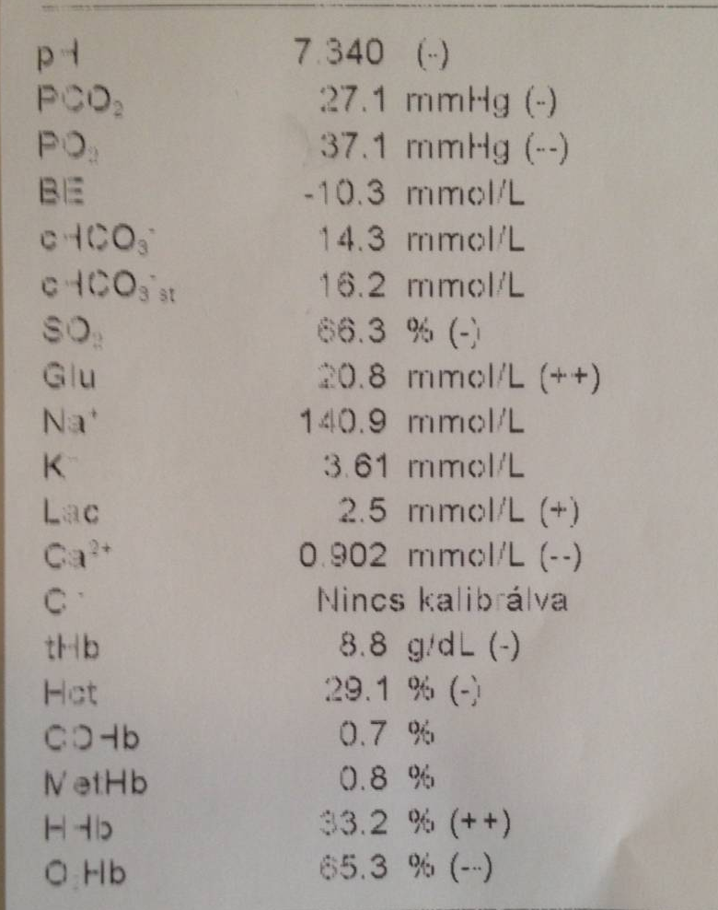
Artery, CVC 14:30
Oxygen + 1000 ml RL: CV-BG
↑pH
↑HCO3
↓Lactate
ScvO2!!

Slide 41
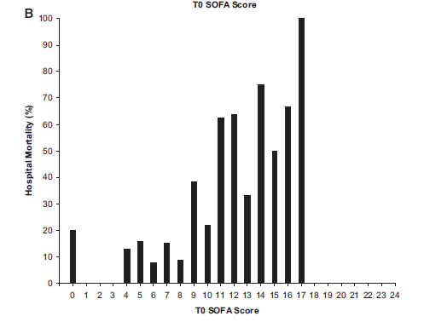
Összefoglalás helyett
Jones AE, et al. Crit Care Med 2009; 37:1649 –1654
Mortality
A frontvonalban dolgozó fiatal orvosok kiemelkedő szerepe!

Slide 42
Mottó
„A diagnózis ráér, de a sejtek türelme véges!” ®

