Slide 1
title
PhD Public Defense
date
name

Slide 2
ABOUT THE STUDENT
DEPARTMENT
SUPERVISOR(S)
SCIENTIFIC METHODOLOGY SUPERVISOR
name
PhD Candidate
VISION:
MISSION:
CONTACT

Slide 3
SPECIFIC GOALS
PROJECT LIST

Slide 4
Evidence-based medicine

Slide 5
PROJECT 1:
SYSTEMATIC REVIEW AND META-ANALYSIS
Supervisors:
Co-investigator:
Scientific Methodology Supervisors:
Statistician:
Project student:

Slide 6
What? - Background
Cause
Solution?
Mortality
20%¹
Notes:
6

Slide 7
Why? - Premise

Slide 8
How? - Methodology
RESEARCH FRAMEWORK

Slide 9
Aim
Notes:
1- so with this study, we aim to analyze the data available from clinical trials in order to test the efficacy of steroids in reducing complication rates following liver surgery.

Slide 10
Systematic search
Databases:
Date of search:
Searchkey:
9243
  N⁰ of records before the duplicate removal
8266
  N⁰ of records after the duplicate removal
22
  N⁰ of eligible studies based title and abstract
11
  N⁰ of eligible full-texts

Slide 11
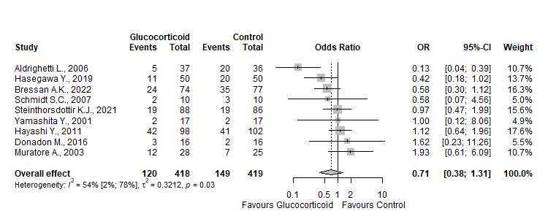
Overall postoperative complication rate
OR = 0.71
p= 0.23
Figure 1. Forest plot of overall postoperative complication rate („events” refer to number of patients who had any complication)
Notes:
The likelihood of a patient who experienced a complication being in the control group is 29% higher.

Slide 12
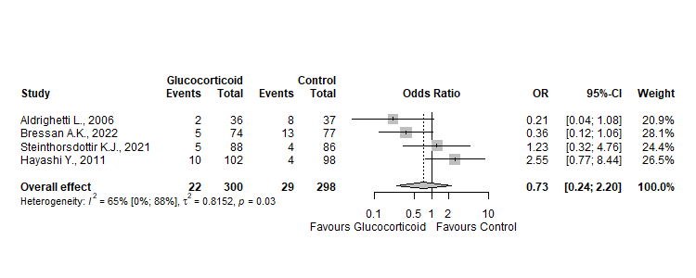
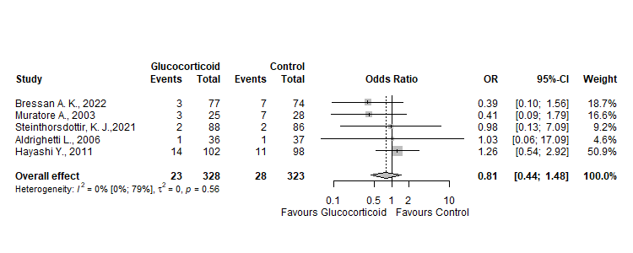
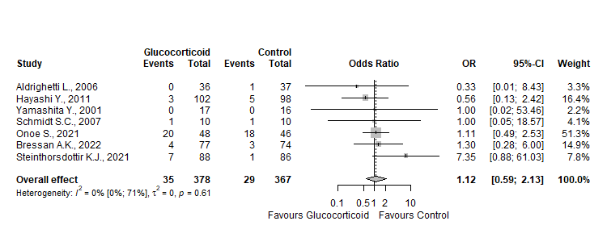
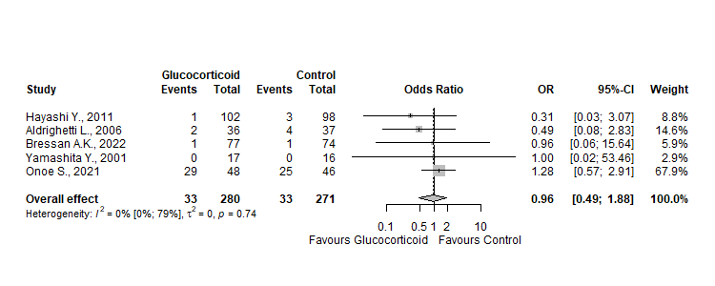
Postoperative complications
Septic/Infectious Complications
Pleural Effusion
Bile Leakage
Liver Failure

Slide 13
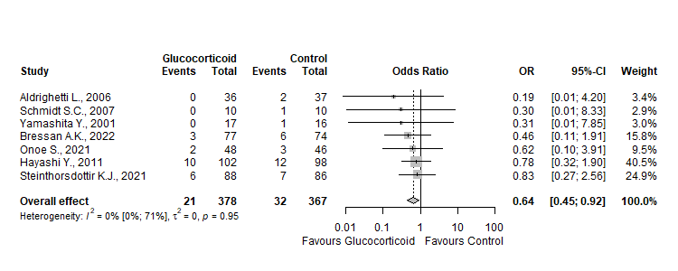
Wound Infections
Measurement/reporting bias?
High heterogeneity?
Low quality of evidence?
OR = 0.64
p= 0.02

Slide 14
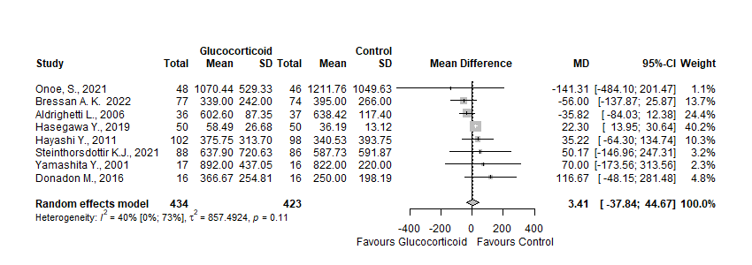
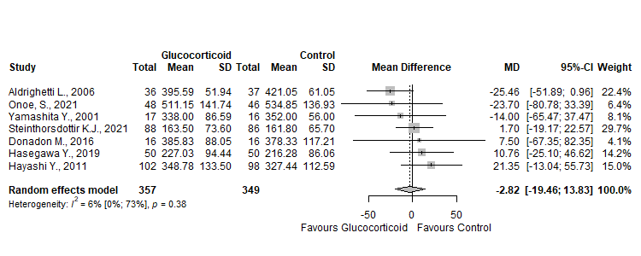
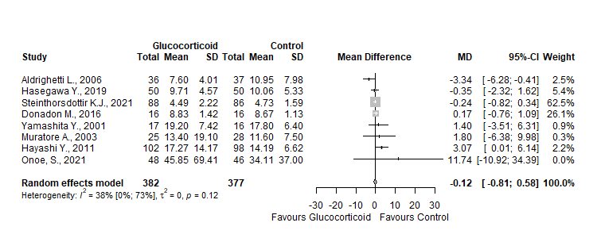
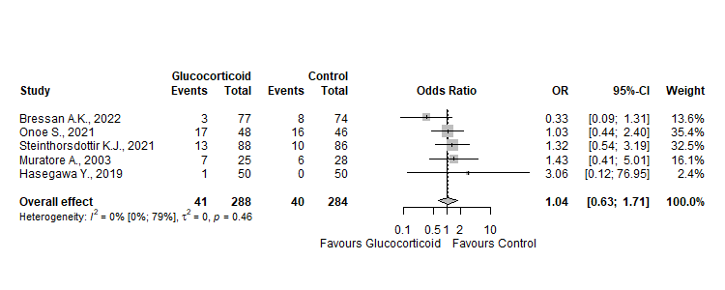
Perioperative outcomes
Length of Hospital Stay
Total Operative Time
Blood Loss
Blood Transfusions

Slide 15


Laboratory Outcomes
Article | Study Type | Treatment Used | Treatment Dosage | Patients, control / intervention (#) | Total Bilirubin | ALT | AST | IL-6 | CRP | PTT
Onoe, S 2021 | RCT | Hydrocortisone | 500 mg immediately before hepatic pedicle clamping followed by 300 mg on POD 1, 200 mg on POD 2, and 100 mg on POD 3 | 46/48
Steinthorsdottir, K. J. 2021 | RCT | Methylprednisolone | 10 mg/kg | 86/88
Bressan, A. K. 2022 | RCT | Methylprednisolone | 500 mg IV pre-operatively | 74/77
Hasegawa, Y. 2019 | RCT | Methylprednisolone | 500 mg IV pre-operatively | 50/50
Donadon, M. 2016 | RCT | Methylprednisolone | 500 mg pre-operatively | 16/16
Hayashi, Y. 2011 | RCT | Hydrocortisone | 500 mg immediately before hepatic pedicle clamping followed by 300 mg on POD 1, 200 mg on POD 2, and 100 mg on POD 3 | 98/102
Yamashita, Y. 2001 | RCT | Methylprednisolone | 500 mg pre-operatively | 16/17
Muratore. A. 2003 | RCT | Methylprednisolone | 30 mg/kg | 28/25
Aldrighetti, L. 2006 | RCT | Methylprednisolone | 500 mg pre-operatively | 36/37
Schmidt, S.C. 2007 | RCT | Methylprednisolone | 30 mg/kg | 10/10
Turner, S. 2006 | RCT | Methylprednisolone | 10 mg/kg | 17/17
Ø
Significant Improvement
Ø
Ø
Ø
Ø
Ø
Ø
Ø
Ø
No Significant Improvement
Ø
Ø
Ø
Ø
Ø
Ø
Ø
No Information
Ø
Ø
Ø
Ø
Ø
Ø
Ø
Ø
Ø
Ø
Ø
Ø

Slide 16
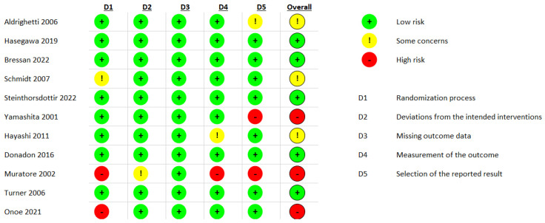
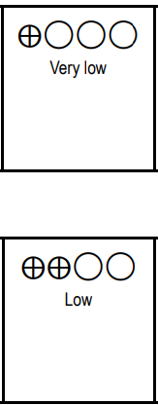
Quality Assessment
Risk of Bias Assessment (RoB2) with GRADE Assessment
Main outcome
Secondary outcomes

Slide 17
Conclusion

Slide 18
Summary

Slide 19
PROJECT 2:
SYSTEMATIC REVIEW AND META-ANALYSIS
Supervisor:
Co-investigator:
Scientific Methodology Supervisor:
Statistician:
Project student:

Slide 20
Why? - Background
Treatment options

Slide 21
What?
Cytokine adsorption
Absorption of inflammatory mediators
Reducing bilirubin and other molecules
Improvement of liver and kidney functions
Bridging to transplant

Slide 22
How? - Methodology
RESEARCH FRAMEWORK

Slide 23
Aim
Notes:
1- So with this study, we aim To summarize and synthesize all currently available literature on hemadsorption therapy in ICU-acquired liver injury in order to formulate hypothesis generating arguments

Slide 24
Systematic search
Databases:
Date of search:
Searchkey:

Slide 25
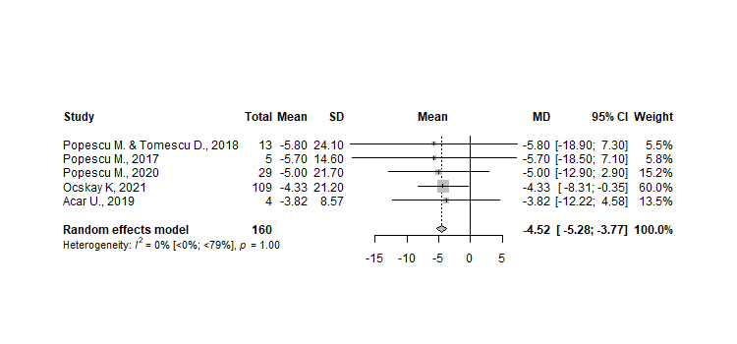
Results
MD = -4.52
p= <.05

Slide 26
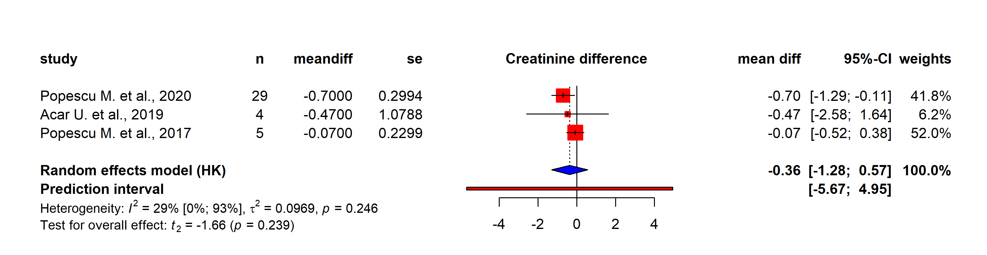
Results
Post-treatment Creatinine (mg/dL)
Figure 2. Forest plot of Creatinine levels change after treatment; HK: hartung-knapp adjustment

Slide 27
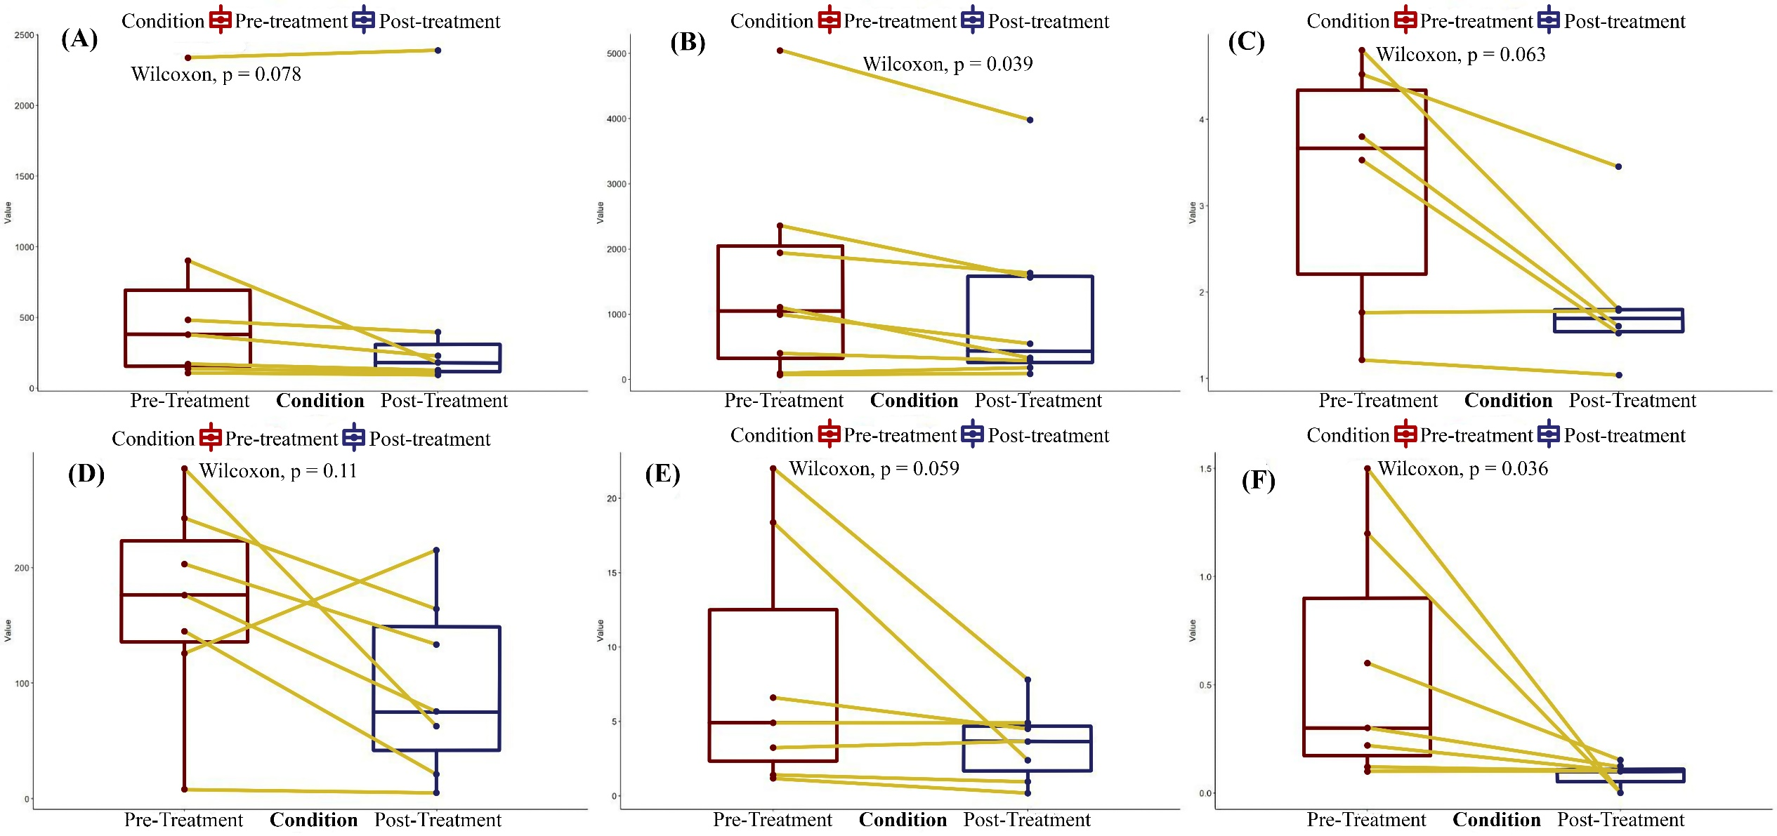
Results
ALT p = 0.078

Slide 28
Conclusion

Slide 29
Summary

Slide 30
Additional Activities

Slide 31
„Quot”
Source of the Quote

